Slide 1

Traveling Salesman Problem
John Franklin Crenshaw

Slide 2
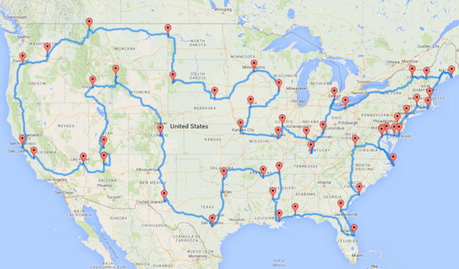
The Traveling Salesman Problem (TSP)
Given a list of locations, what is the shortest round trip?
This is a discrete optimization problem

Slide 3
Outline
Introduce the basic vocabulary and code
Examine the simple (but slow) solution
Look at two (faster) methods for approximating the solution
Simulated Annealing
Genetic Algorithms
Brief look at other possible methods
Applications
Scientific applications of the TSP
Scientific applications of these optimization methods

Slide 4
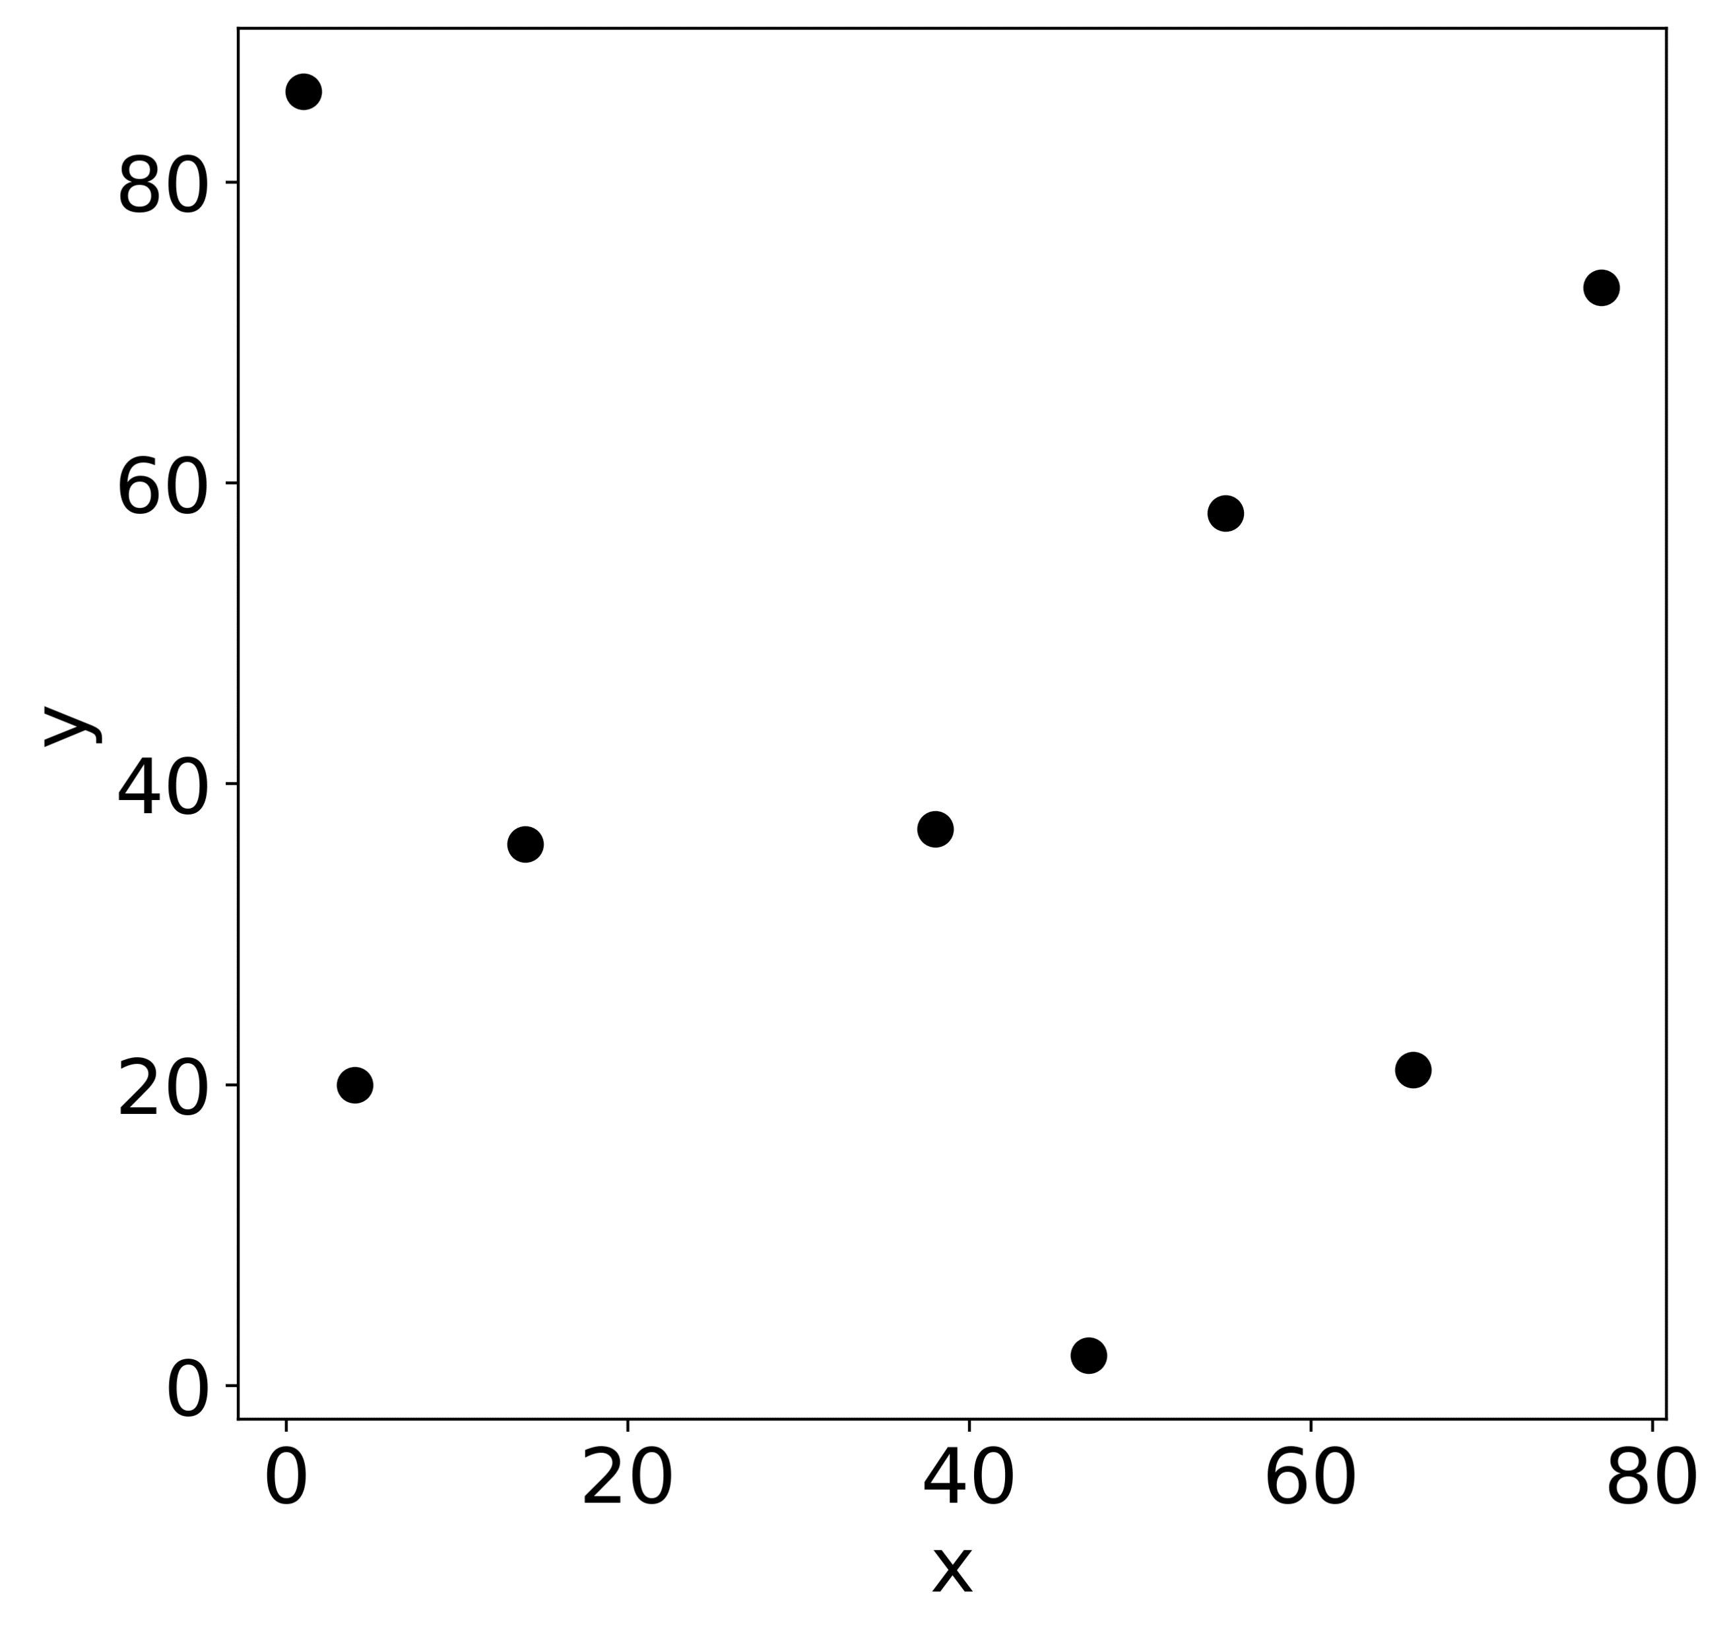
Vocabulary
Cities – locations our traveling salesman needs to visit. Characterized by a location (x,y)

Slide 5
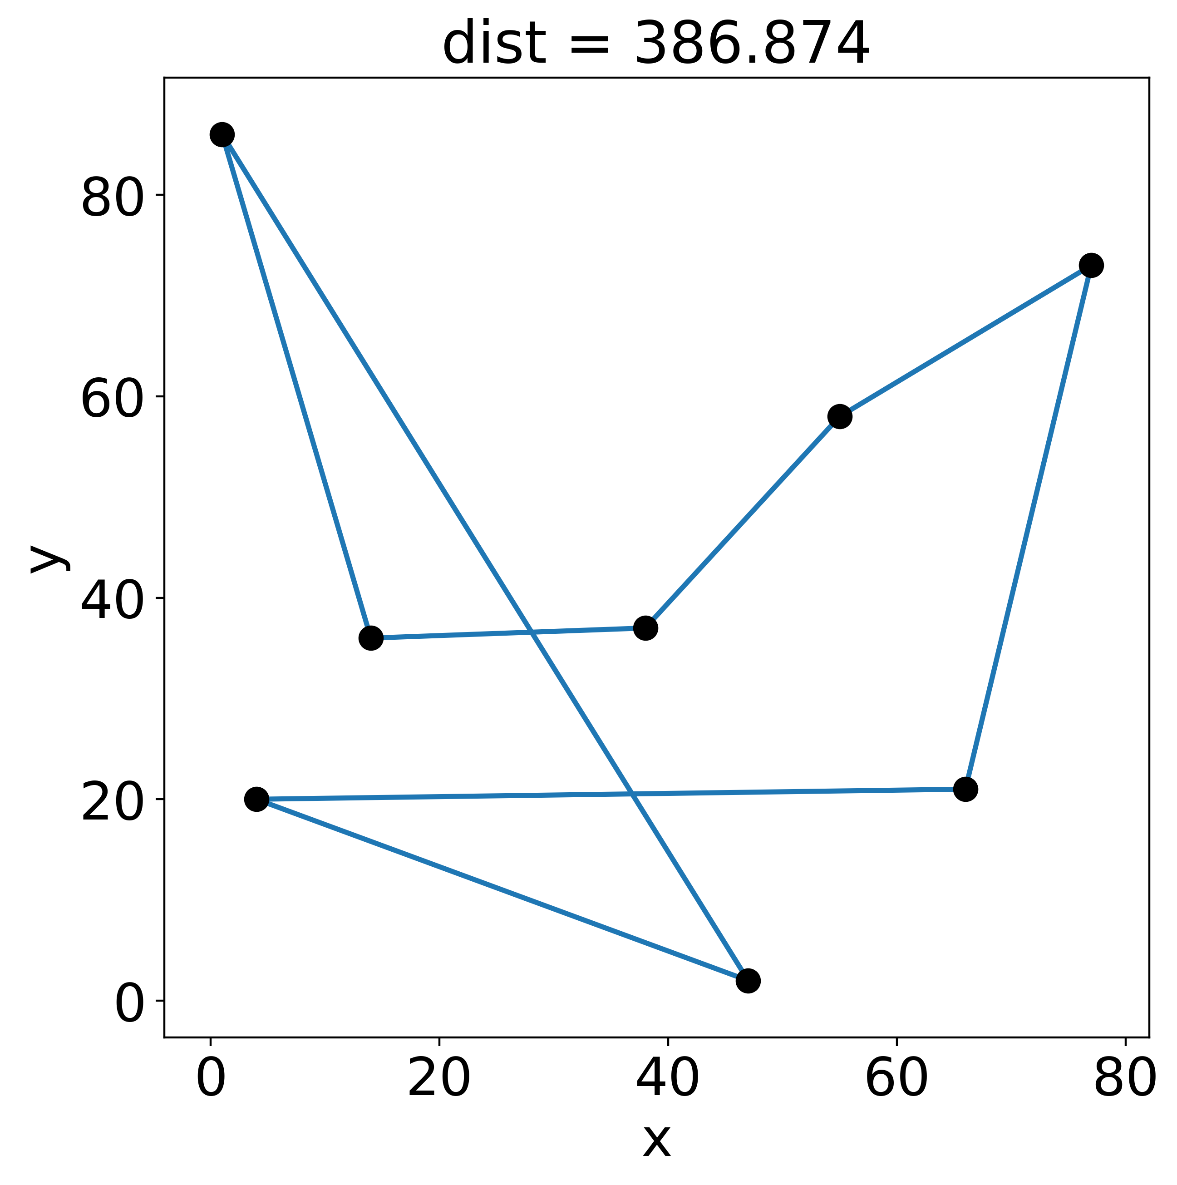
Vocabulary
Cities – locations our traveling salesman needs to visit. Characterized by a location (x,y)
Route – any round-trip path through a set of cities. Characterized by a ordered list:
[city1, city7, city2, city3, …]

Slide 6
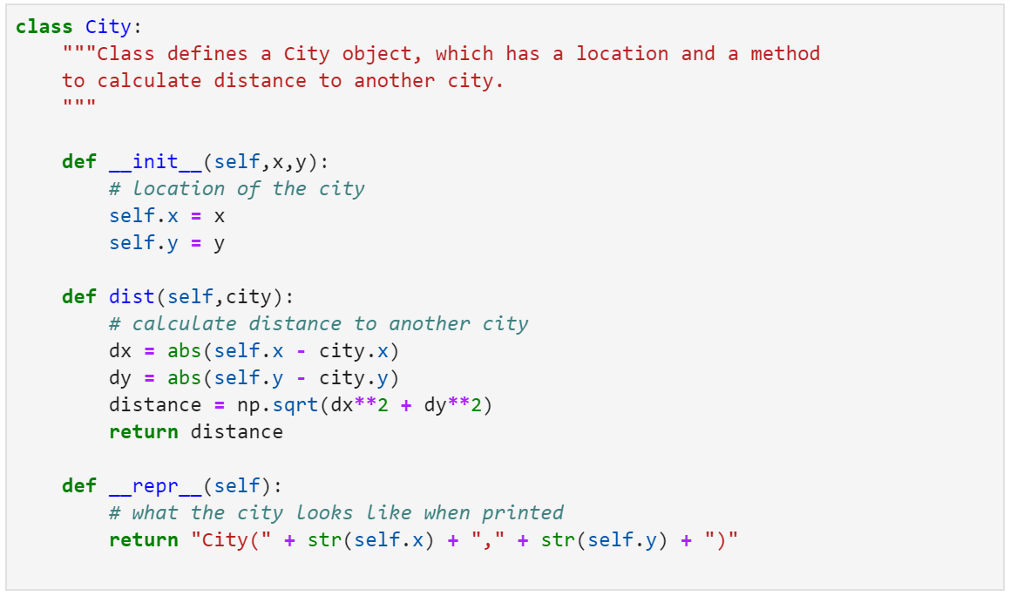
Translating the vocab into code: cities

Slide 7
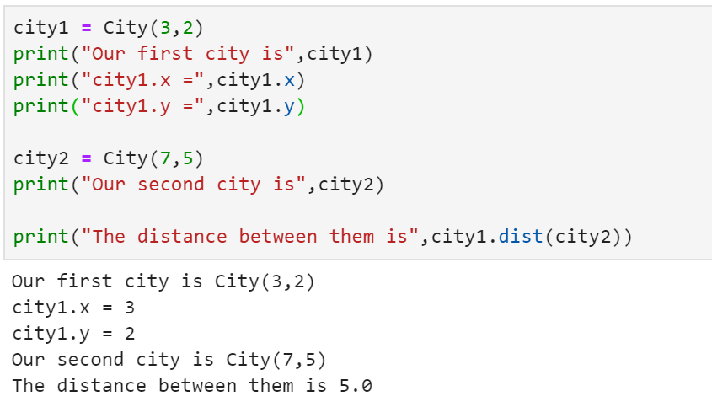
Using the City class

Slide 8
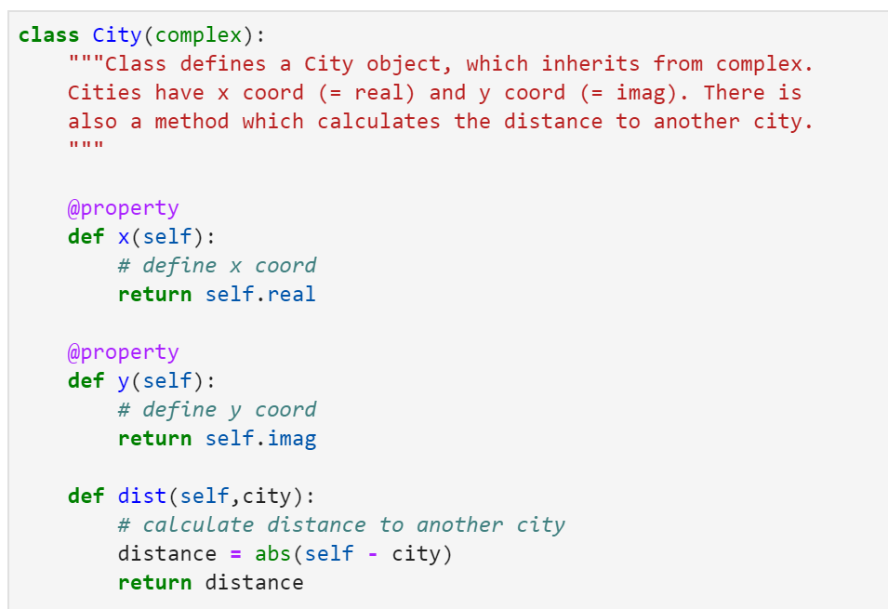
Translating the vocab into code: cities
Now the x and y positions are treated as the real and imaginary parts of a complex number

Slide 9
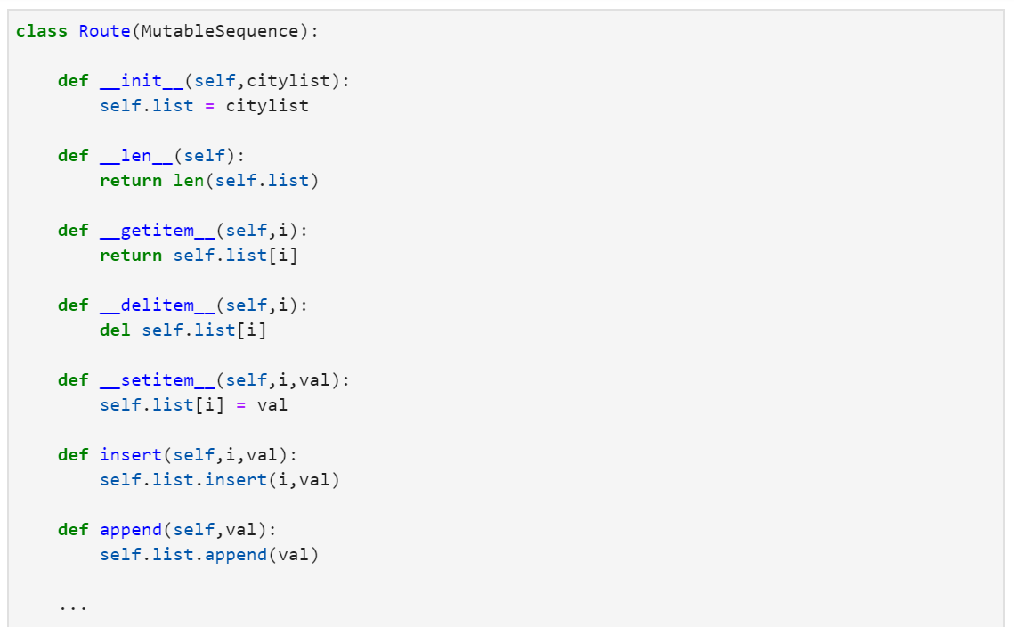
Translating the vocab into code: routes
Required code to make sure it behaves like a list

Slide 10
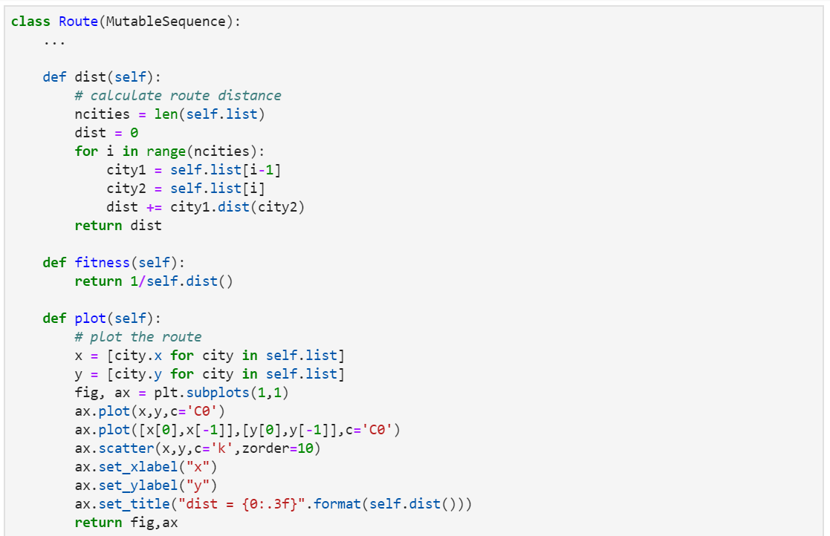
Translating the vocab into code: routes
Method to calculate route distance
Method to plot the route

Slide 11
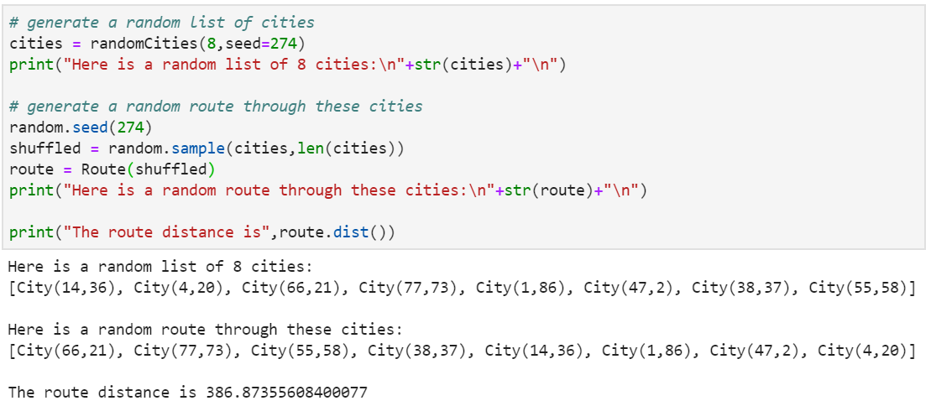
Using the Route class

Slide 12
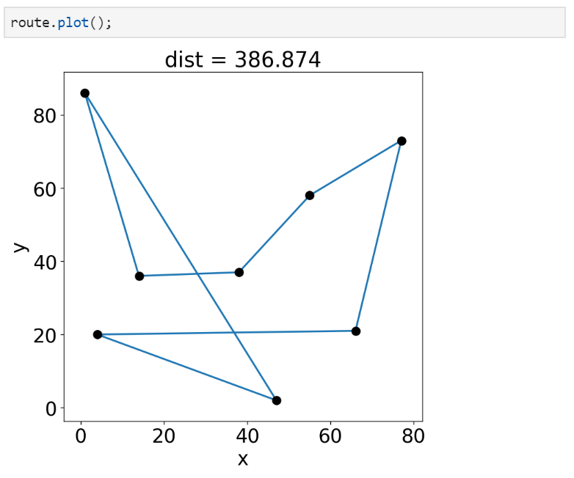
Using the Route class

Slide 13
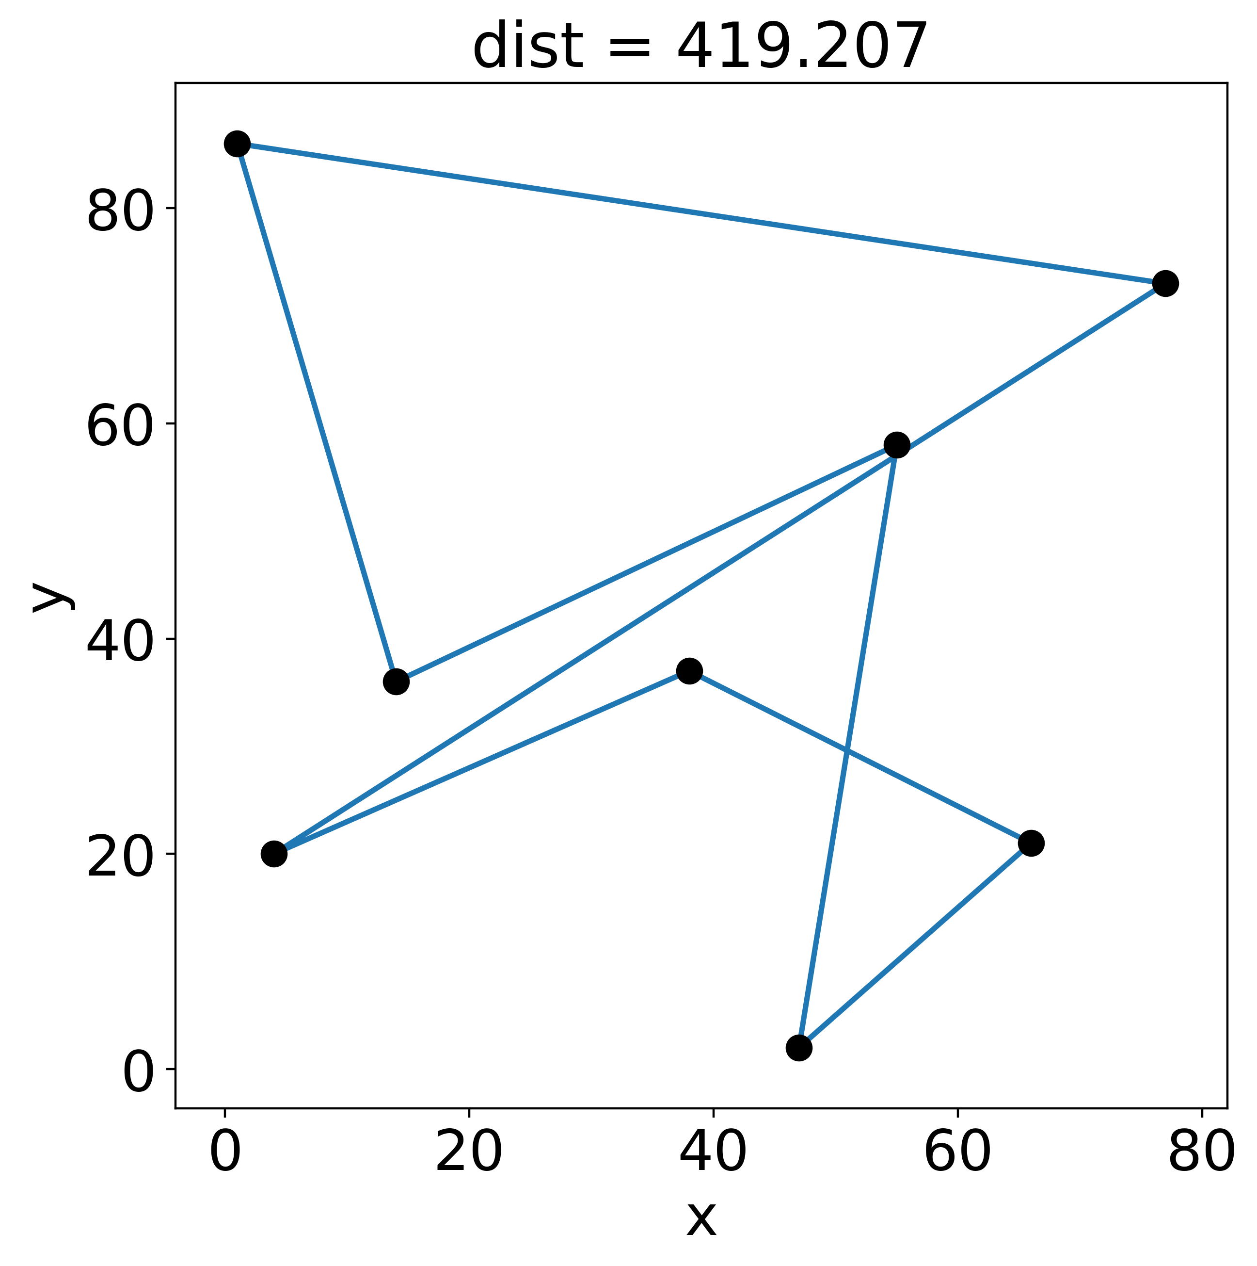
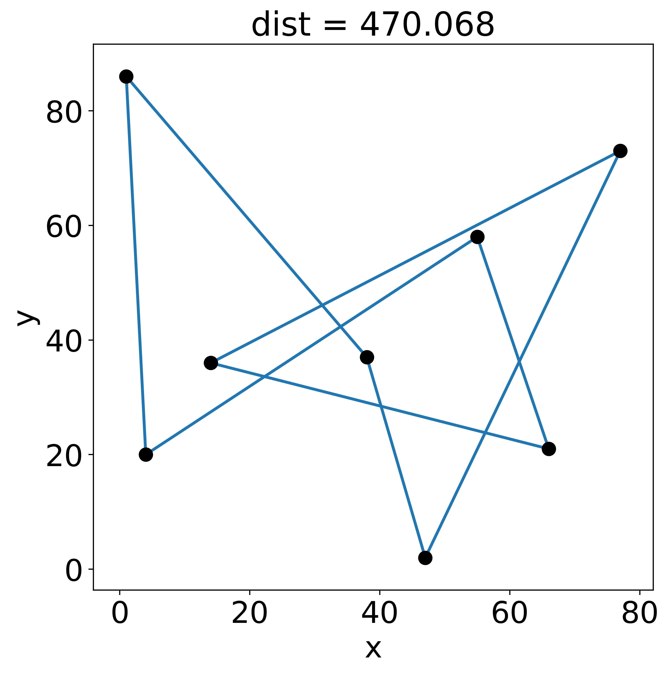
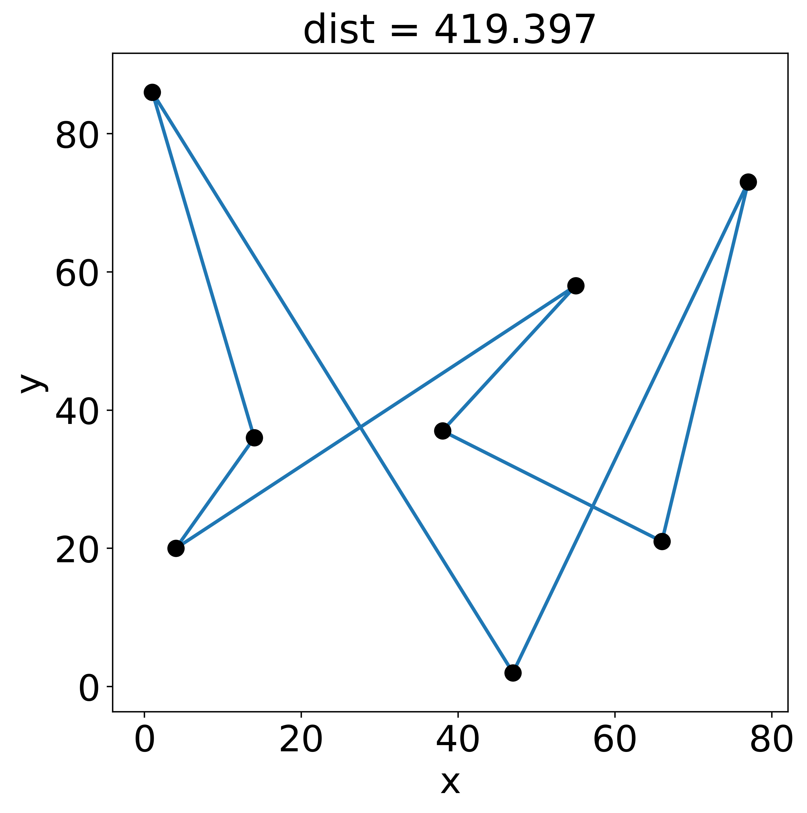
Solving the TSP
Fortunately, the solution to the TSP is trivial!
Given a set of cities, there are only a finite number of possible routes
Check them all, and the shortest is the solution

Slide 14
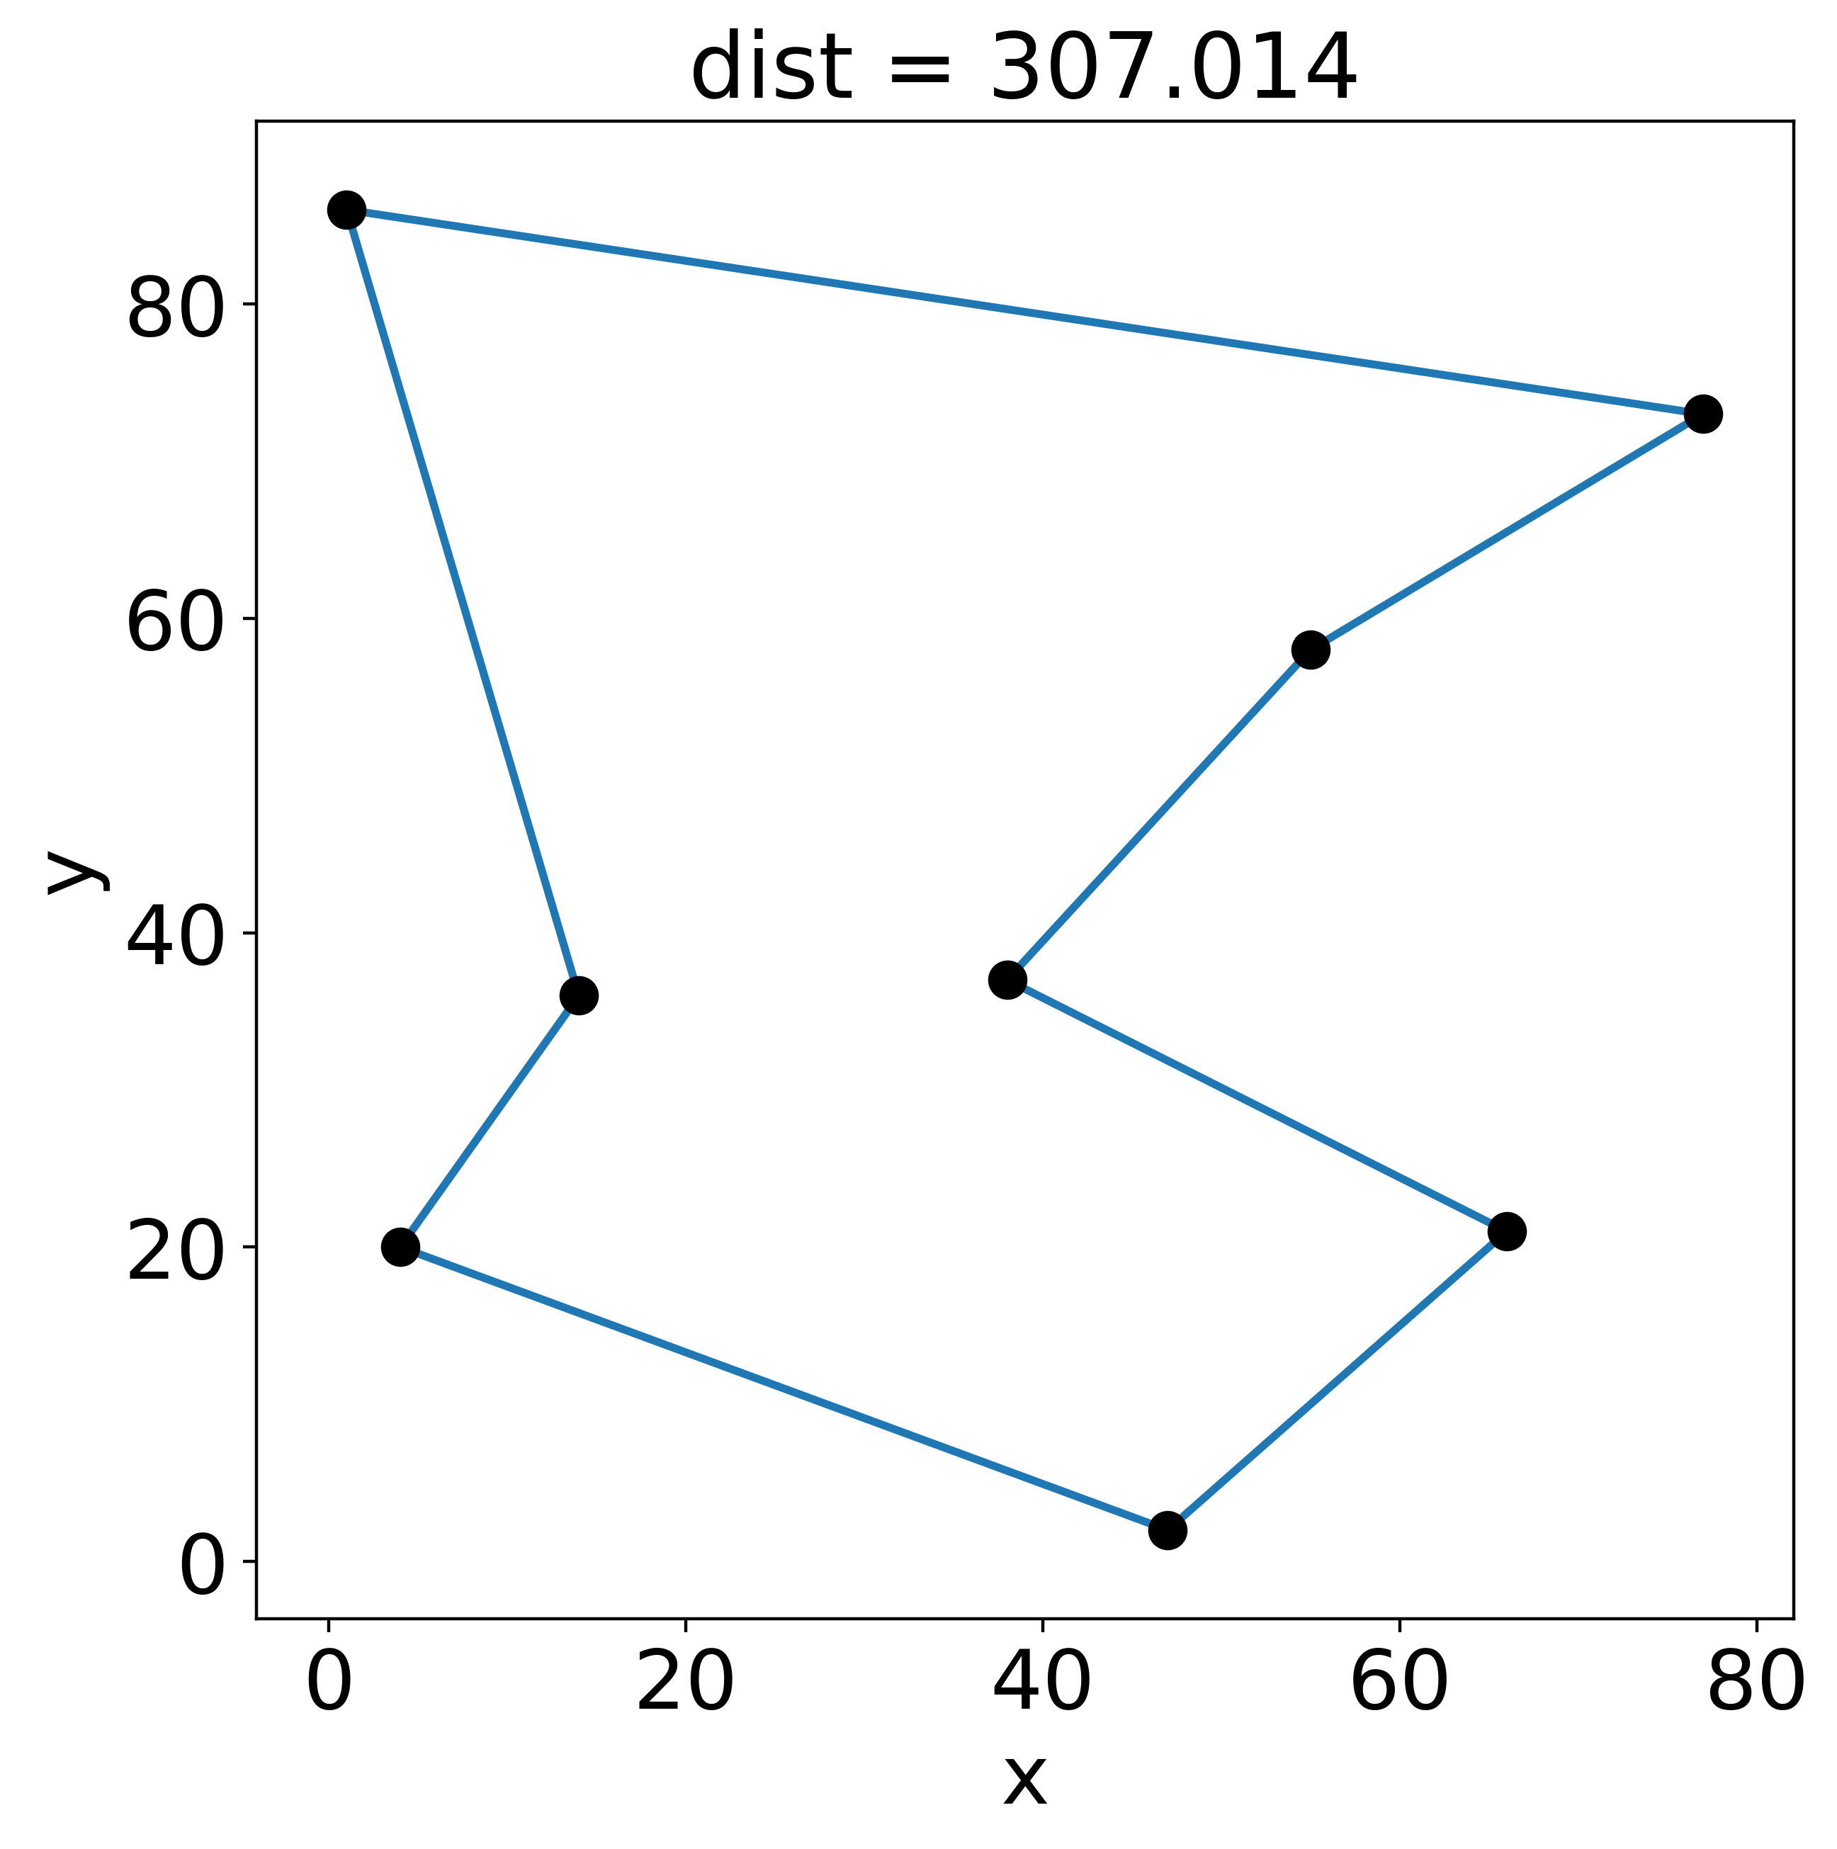
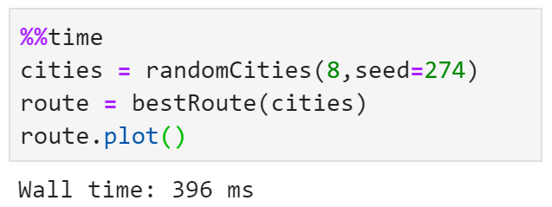
Solving the TSP

Slide 15
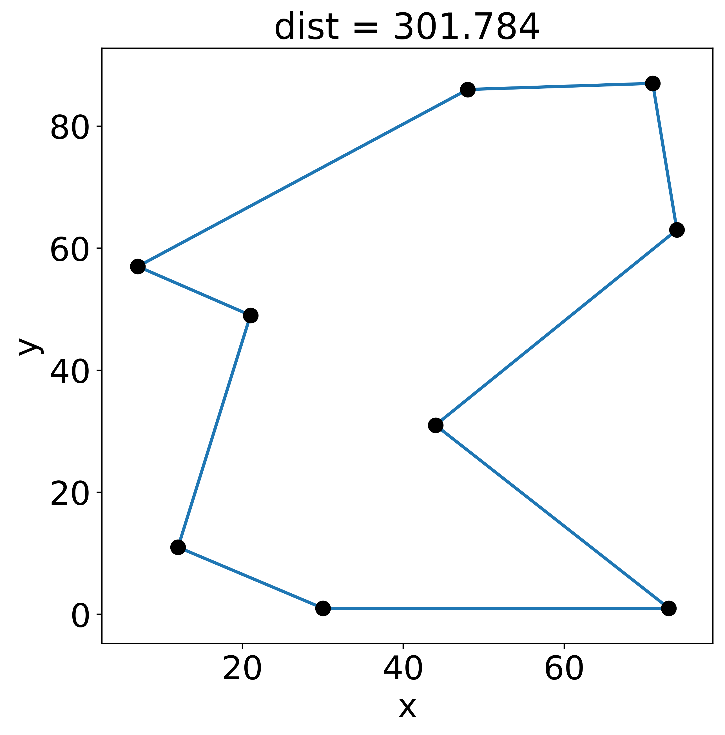
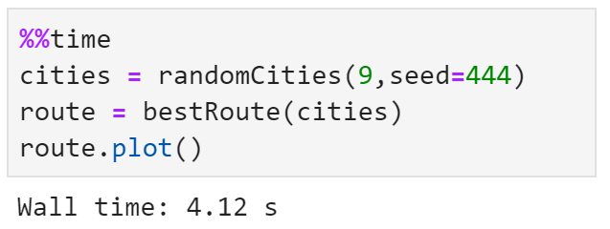
Solving the TSP

Slide 16
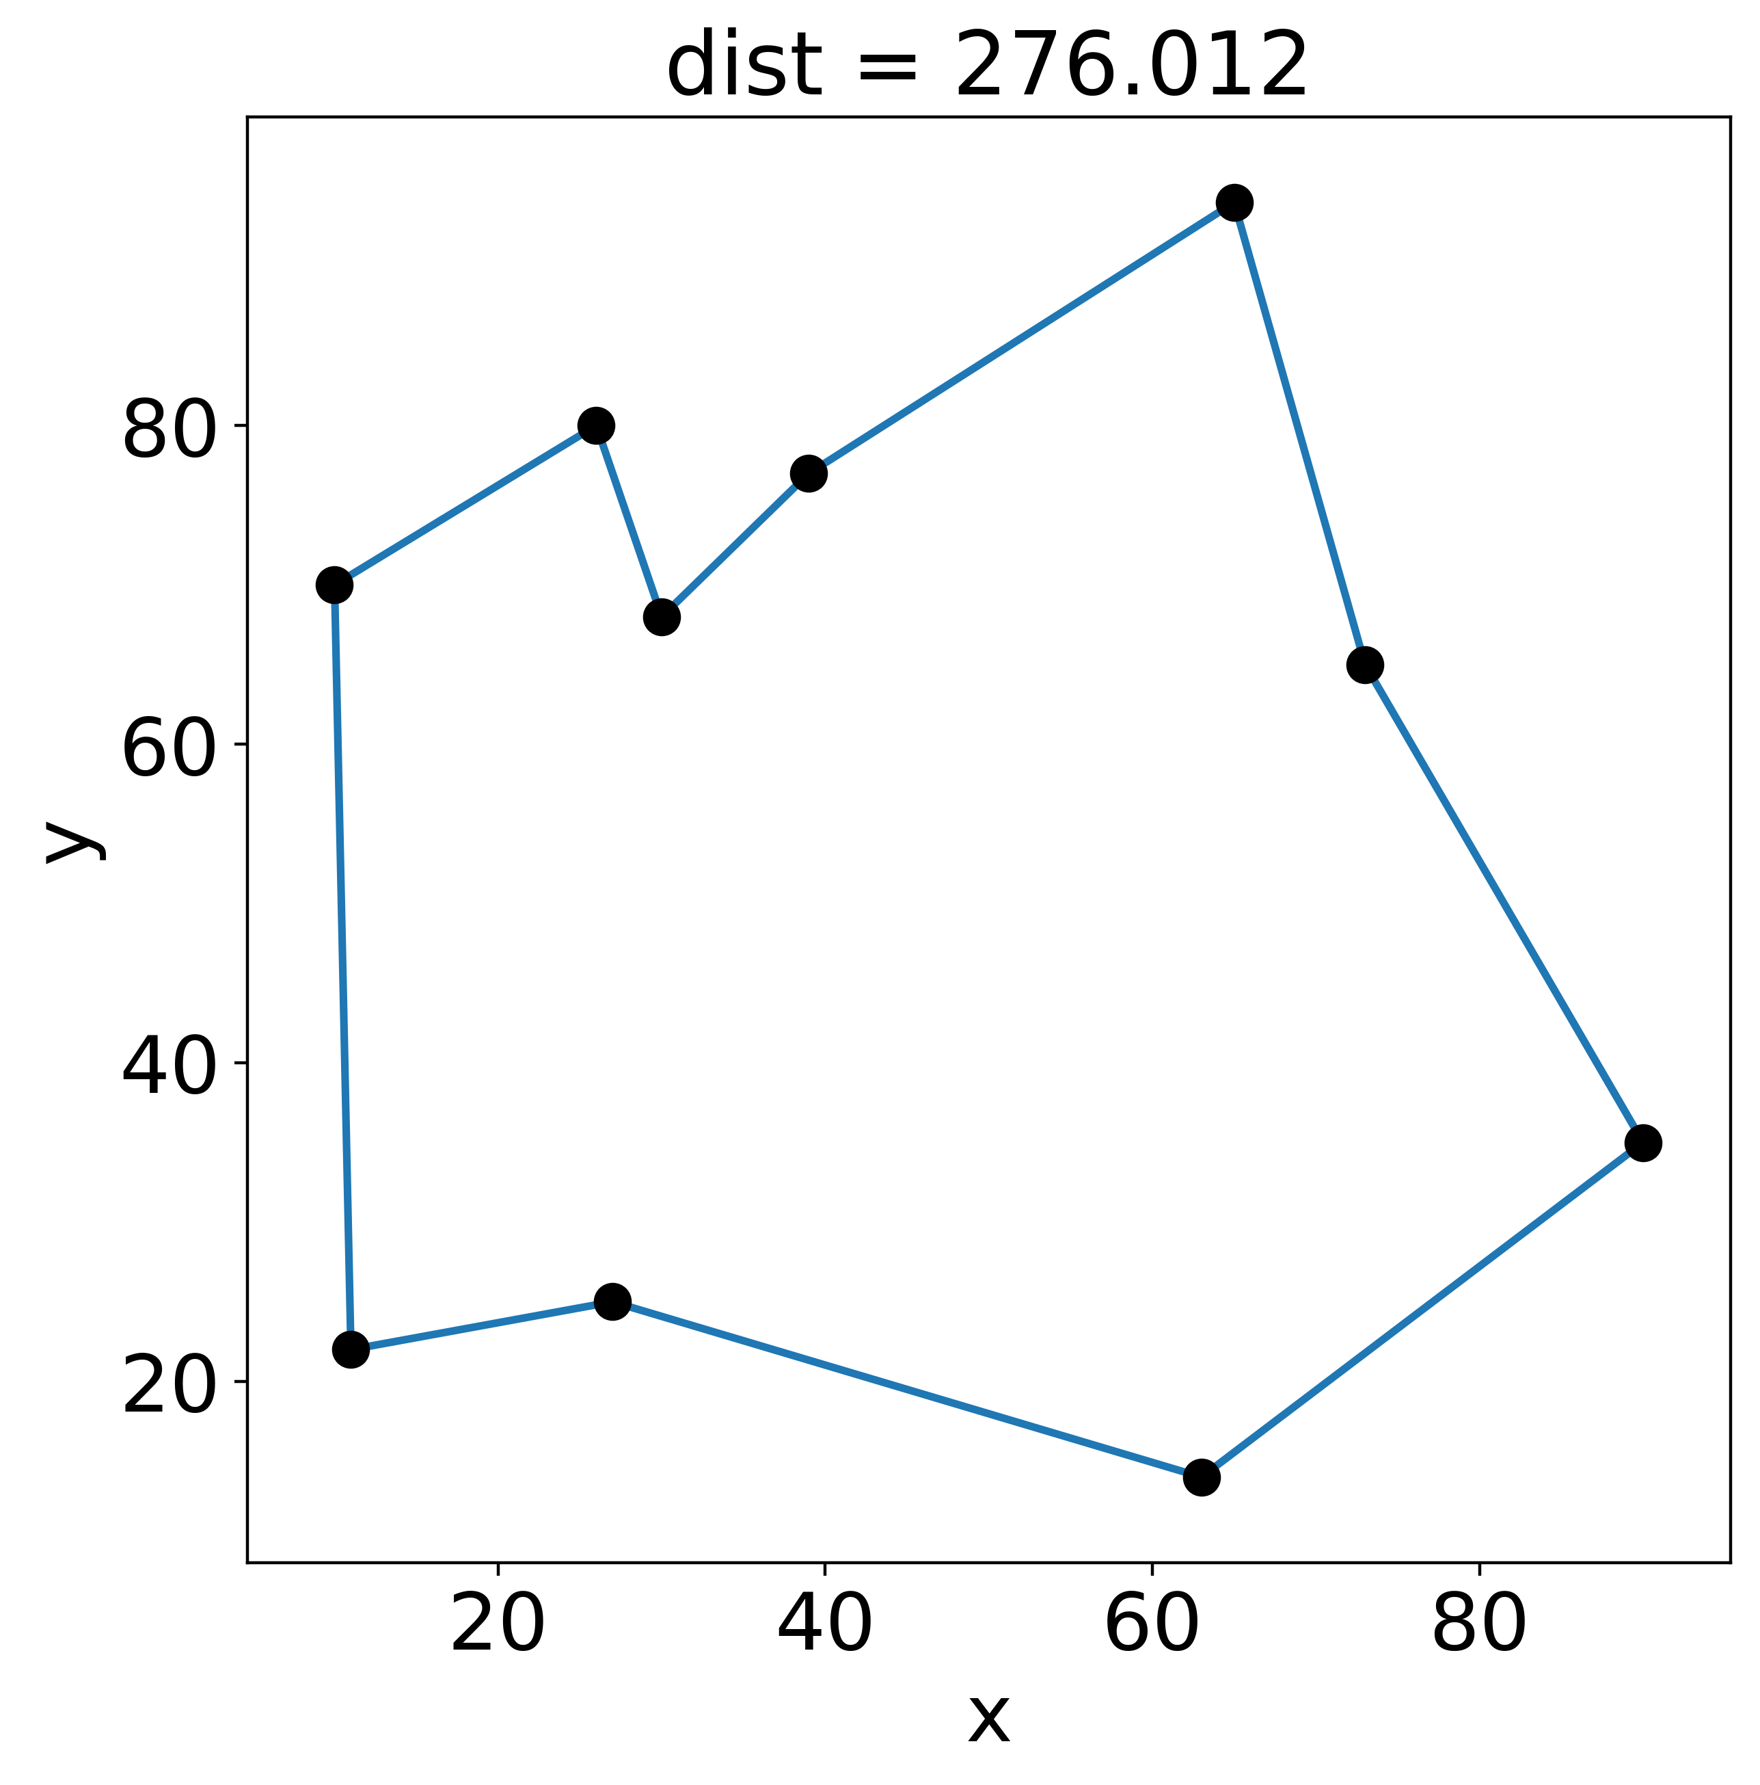
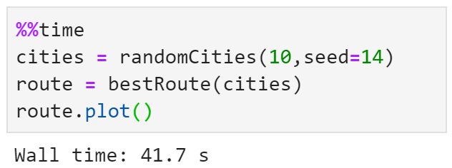
Solving the TSP

Slide 17
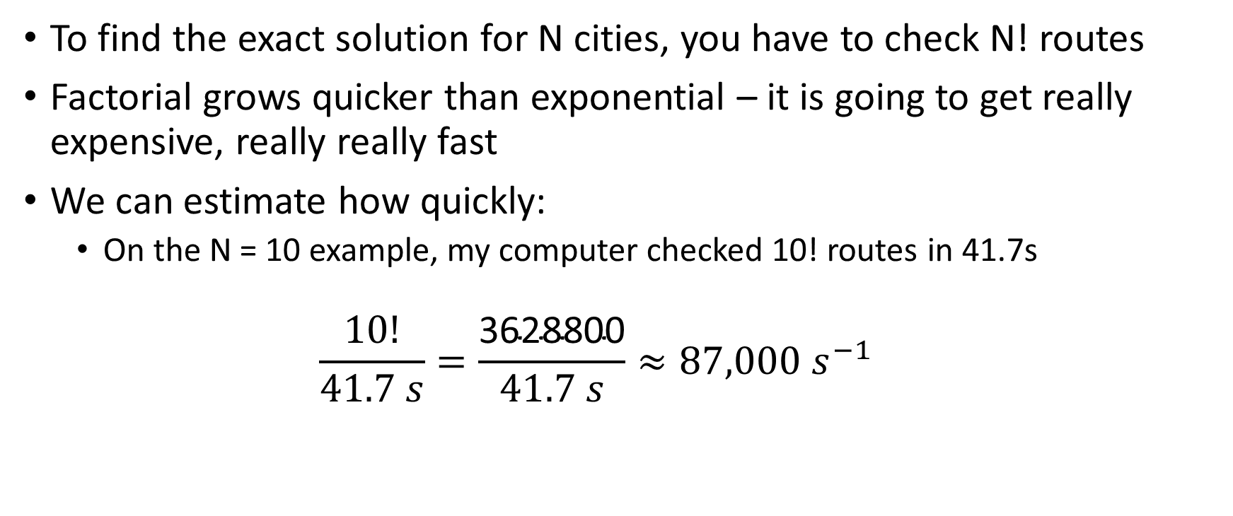
Exact solution is computationally expensive
To find the exact solution for N cities, you have to check N! routes
Factorial grows quicker than exponential – it is going to get really expensive, really really fast
We can estimate how quickly:
On the N = 10 example, my computer checked 10! routes in 41.7s
$$\frac{10!}{41.7 s}=\frac{\text{3628800}}{41.7 s}≈87,000 s^{−1}$$

Slide 18
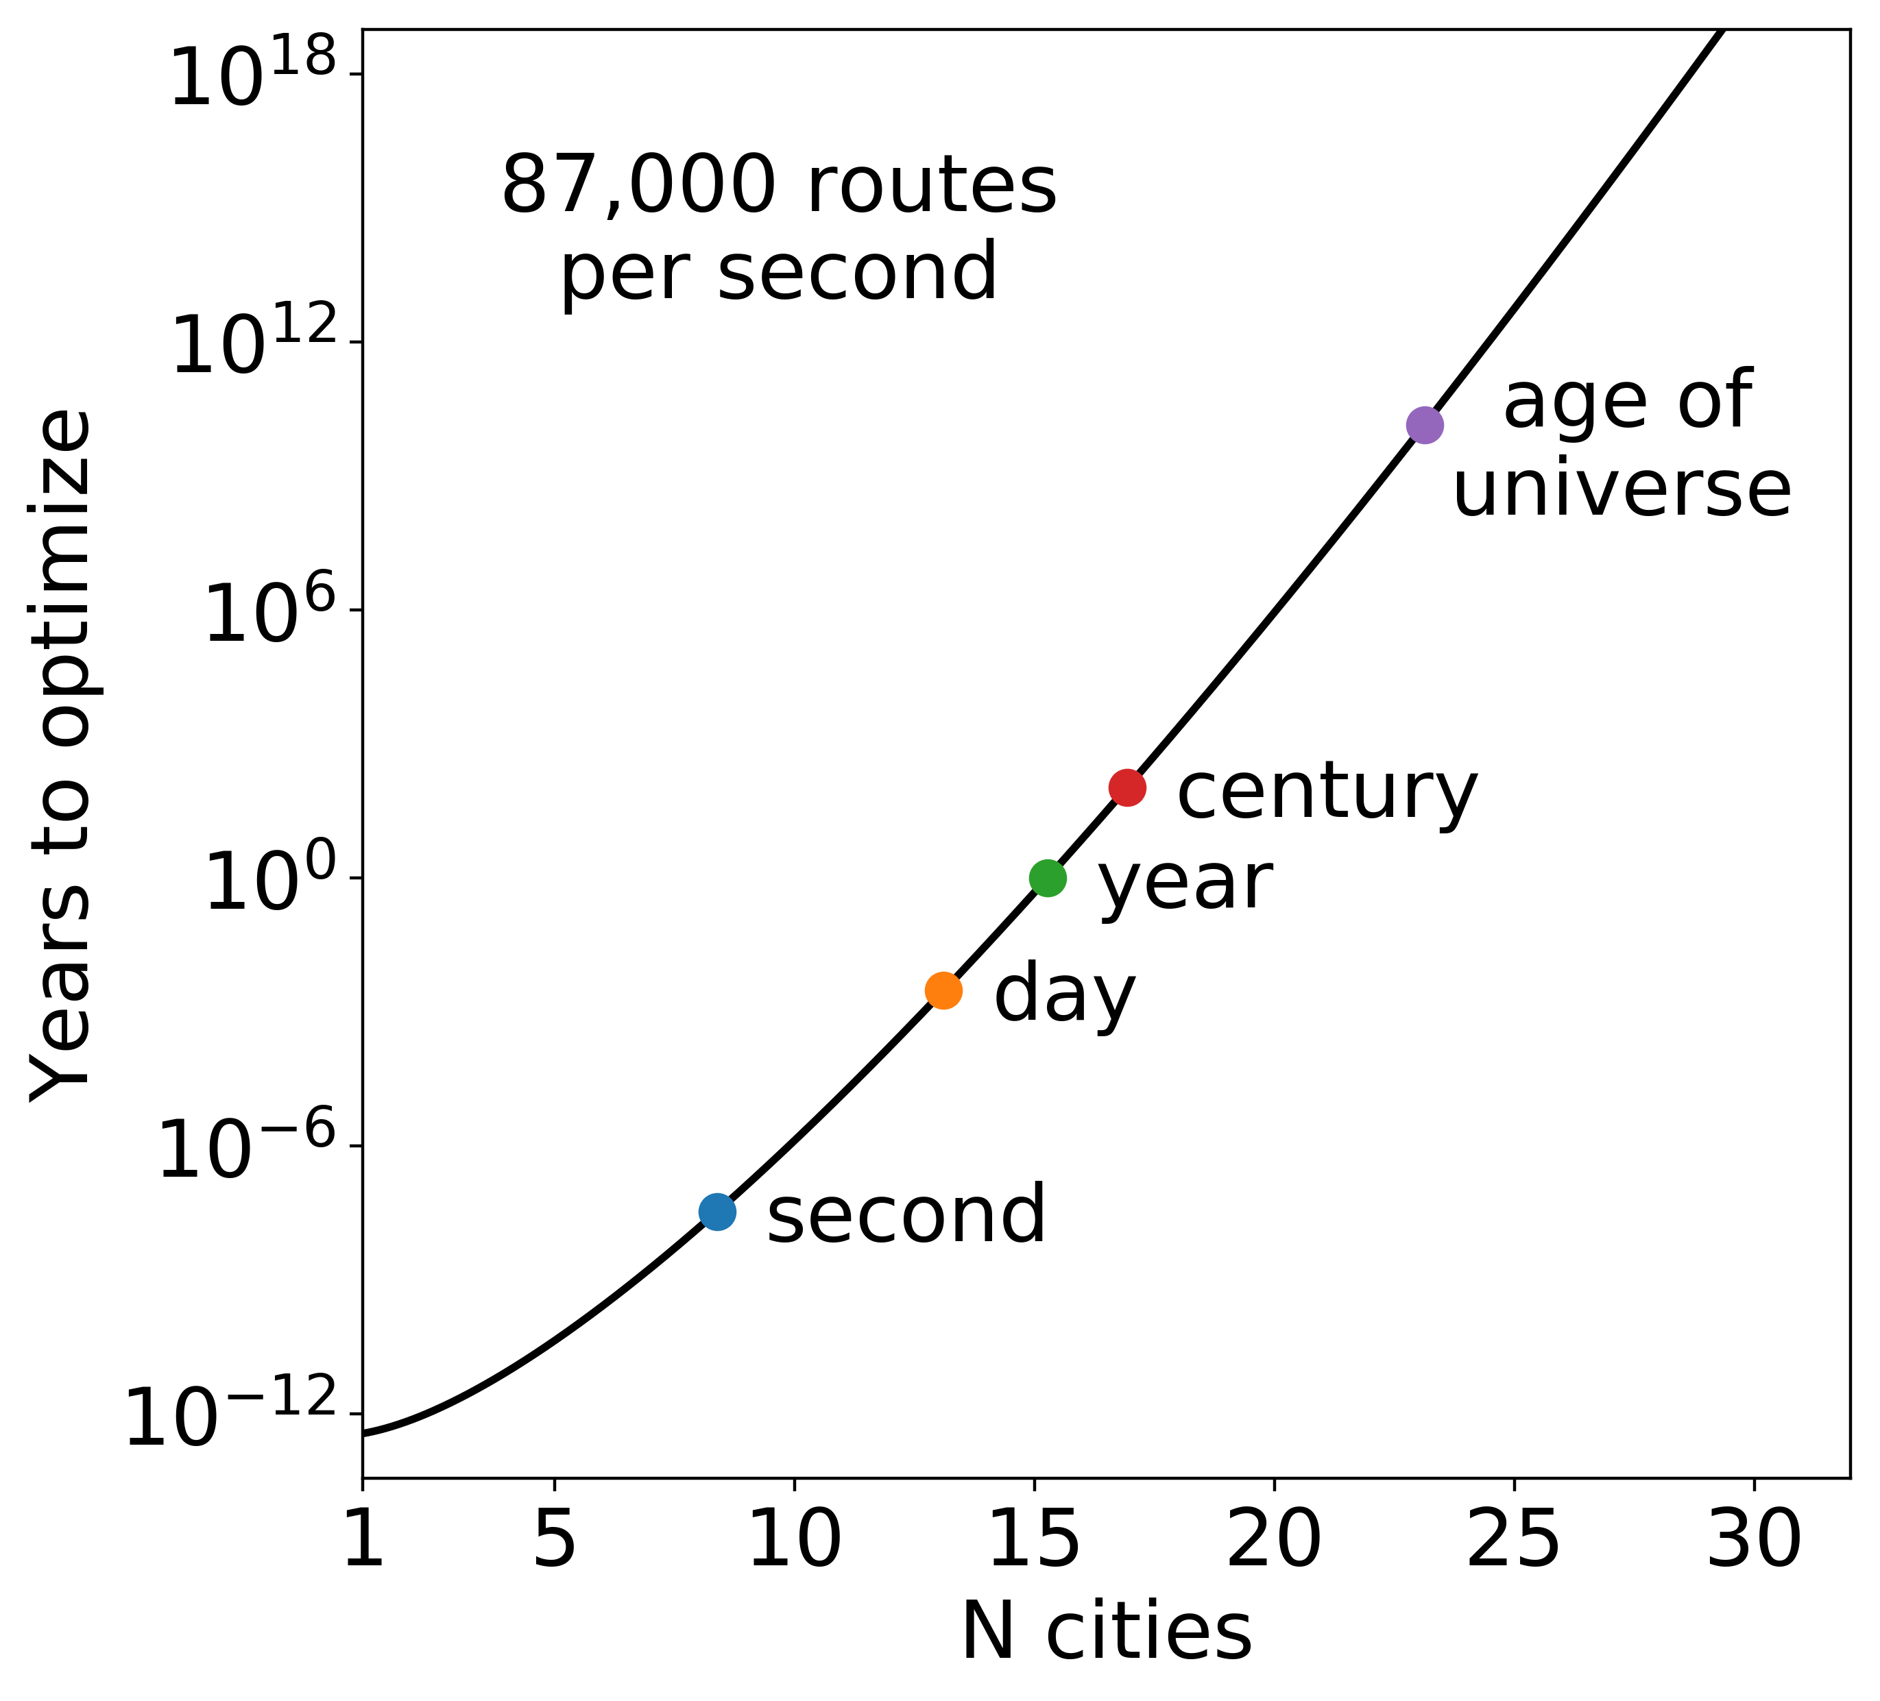
Exact solution is computationally expensive

Slide 19
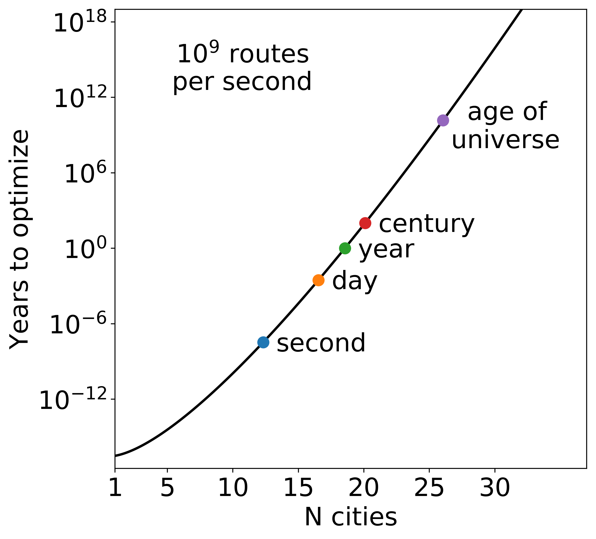
Exact solution is computationally expensive

Slide 20
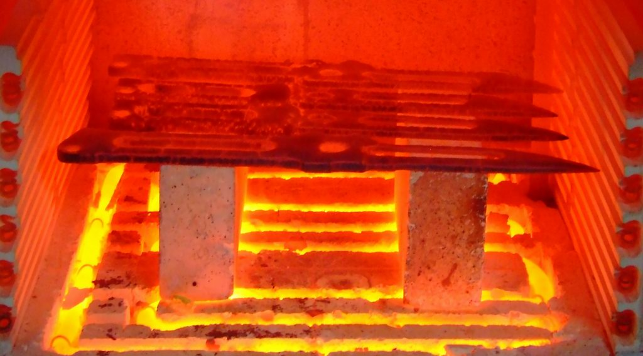

Better methods
This method is infeasible for routes with more than a dozen cities
Instead we can hope to quickly find approximate solutions
There are many ways to do this
We will focus on two
Simulated annealing
Genetic algorithms

Slide 21
Simulated Annealing
Probabilistic technique
Good for approximating global optima in a fixed amount of time
Works by randomly “mutating” a solution
The system has a “temperature” which determines the probability with which we accept worse solutions
As the “temperature” is lowered, it is less likely that we accept worse solutions

Slide 22
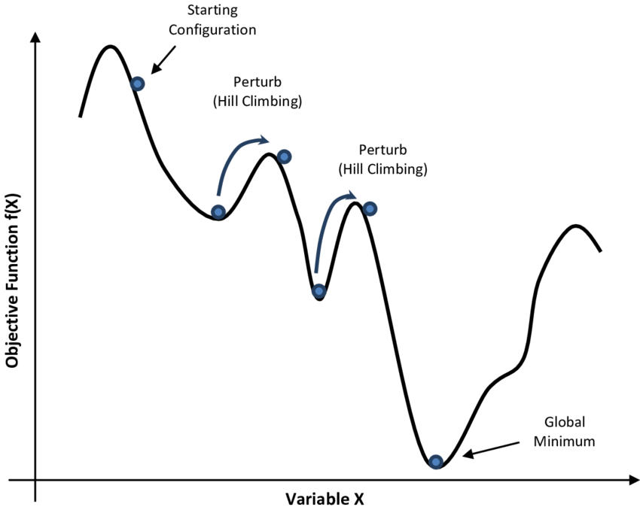
Simulated Annealing
Start with a random solution
At each step, randomly “mutate” your current solution
IF the mutated solution is better, keep it
IF it’s worse, randomly decide with a probability that depends on the “temperature”
Lower the temperature after each step

Slide 23
“Mutating” a route
Randomly select a segment
1
2
3
4
5
6
7
8
50% - Flip
1
4
3
2
5
6
7
8
50% - Move
1
5
6
2
3
4
7
8

Slide 24
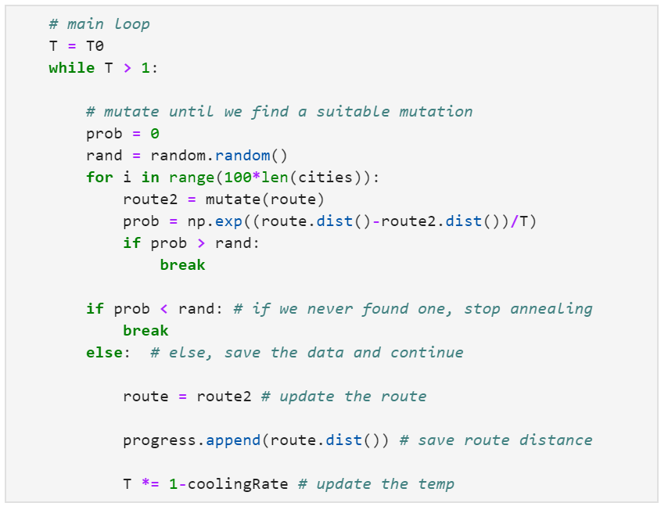
Simulated Annealing Code
Initial temperature
Cooling Rate

Slide 25
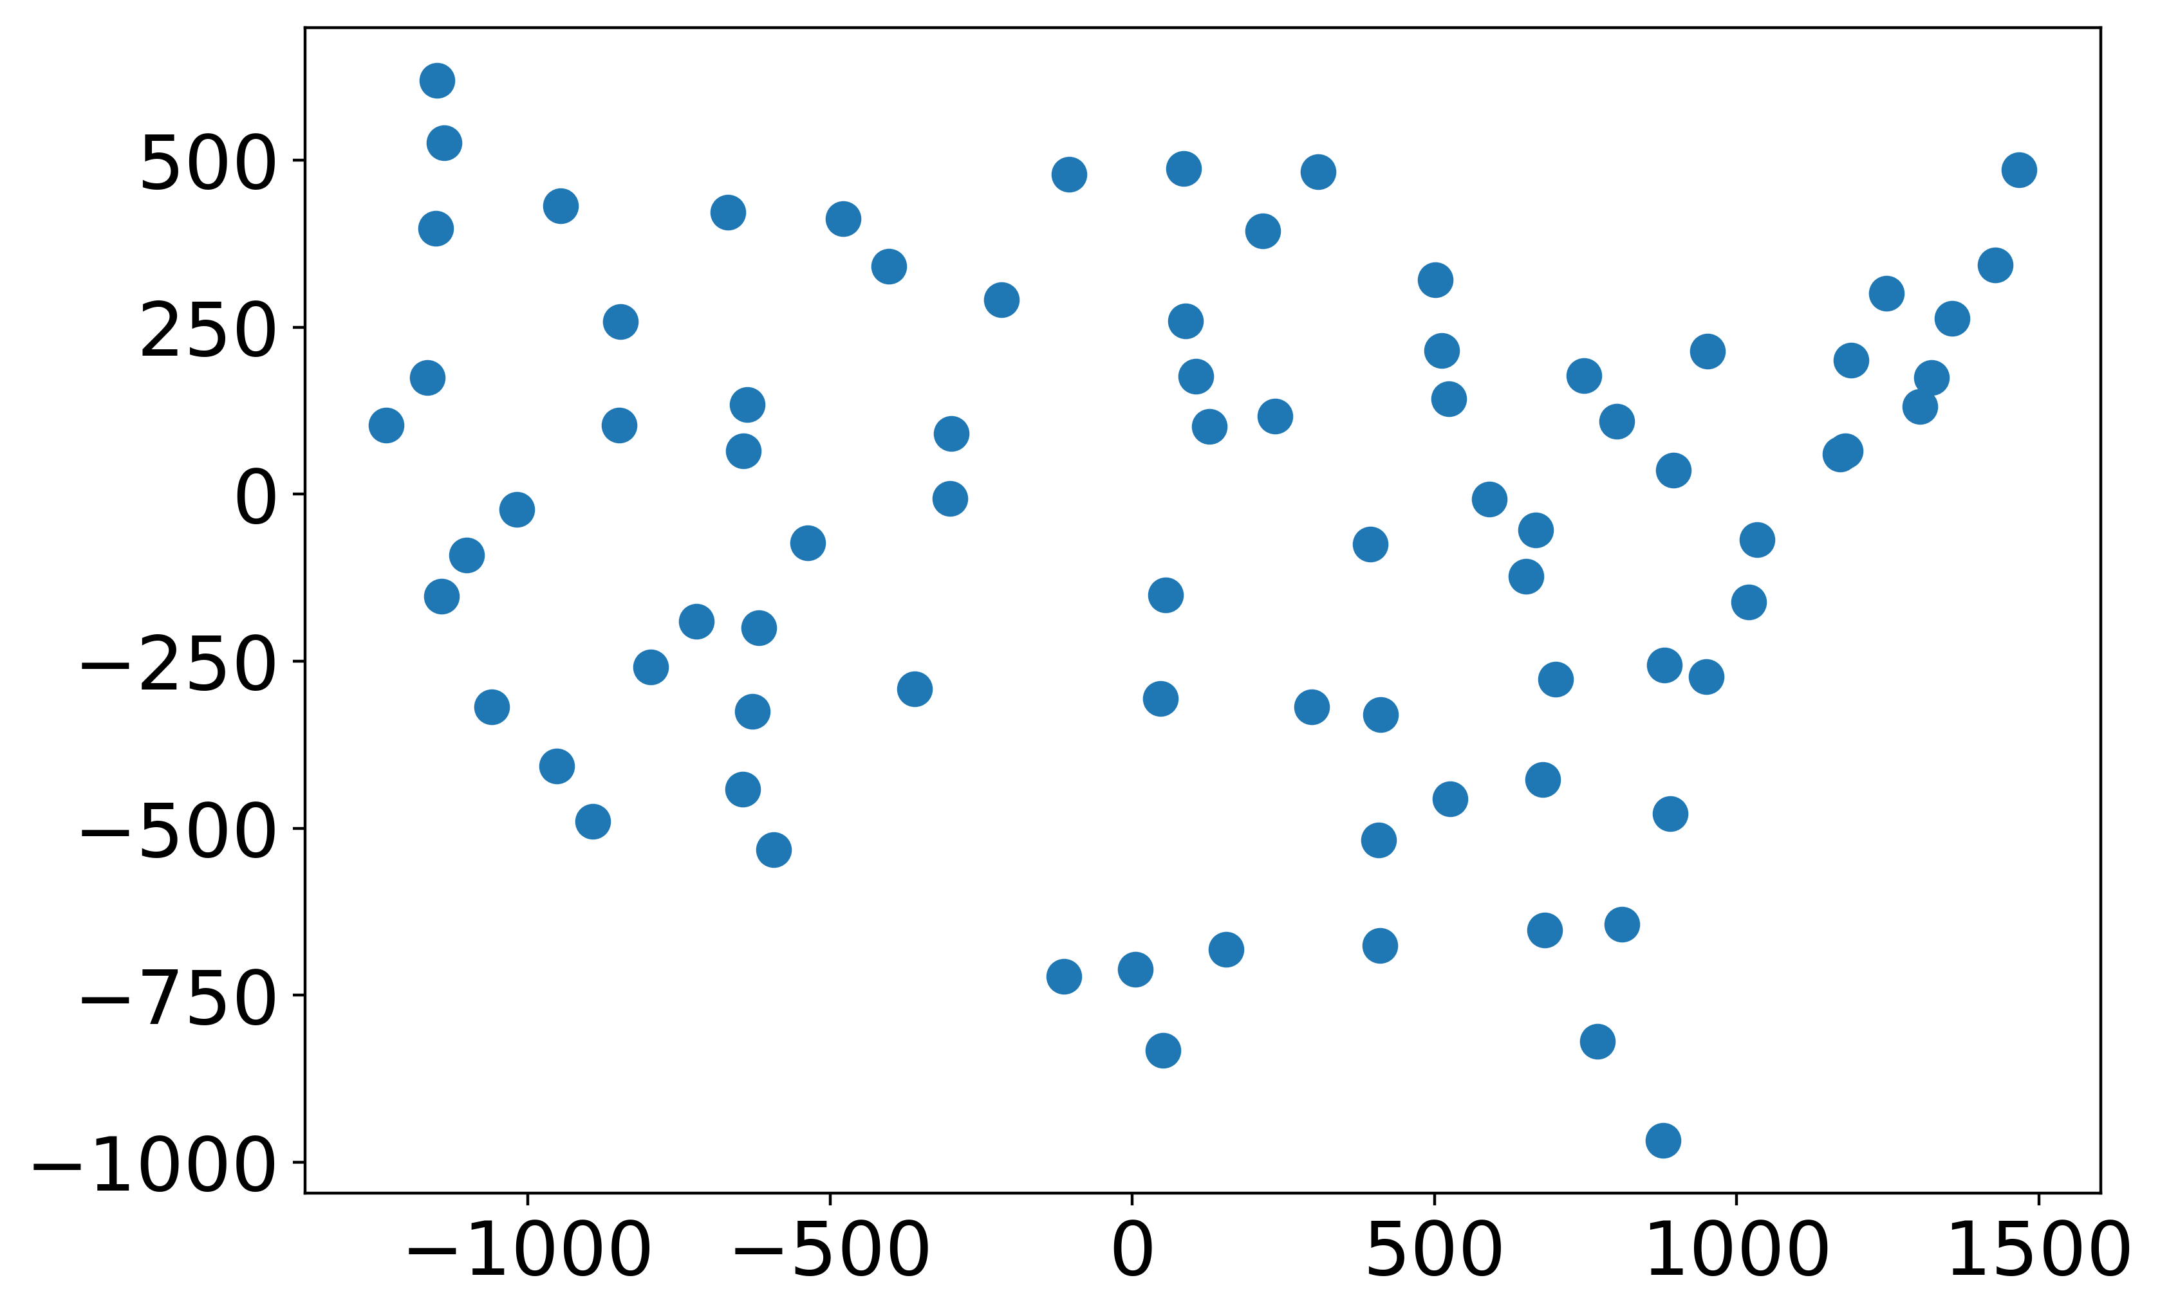
Test on 80 US cities

Slide 26
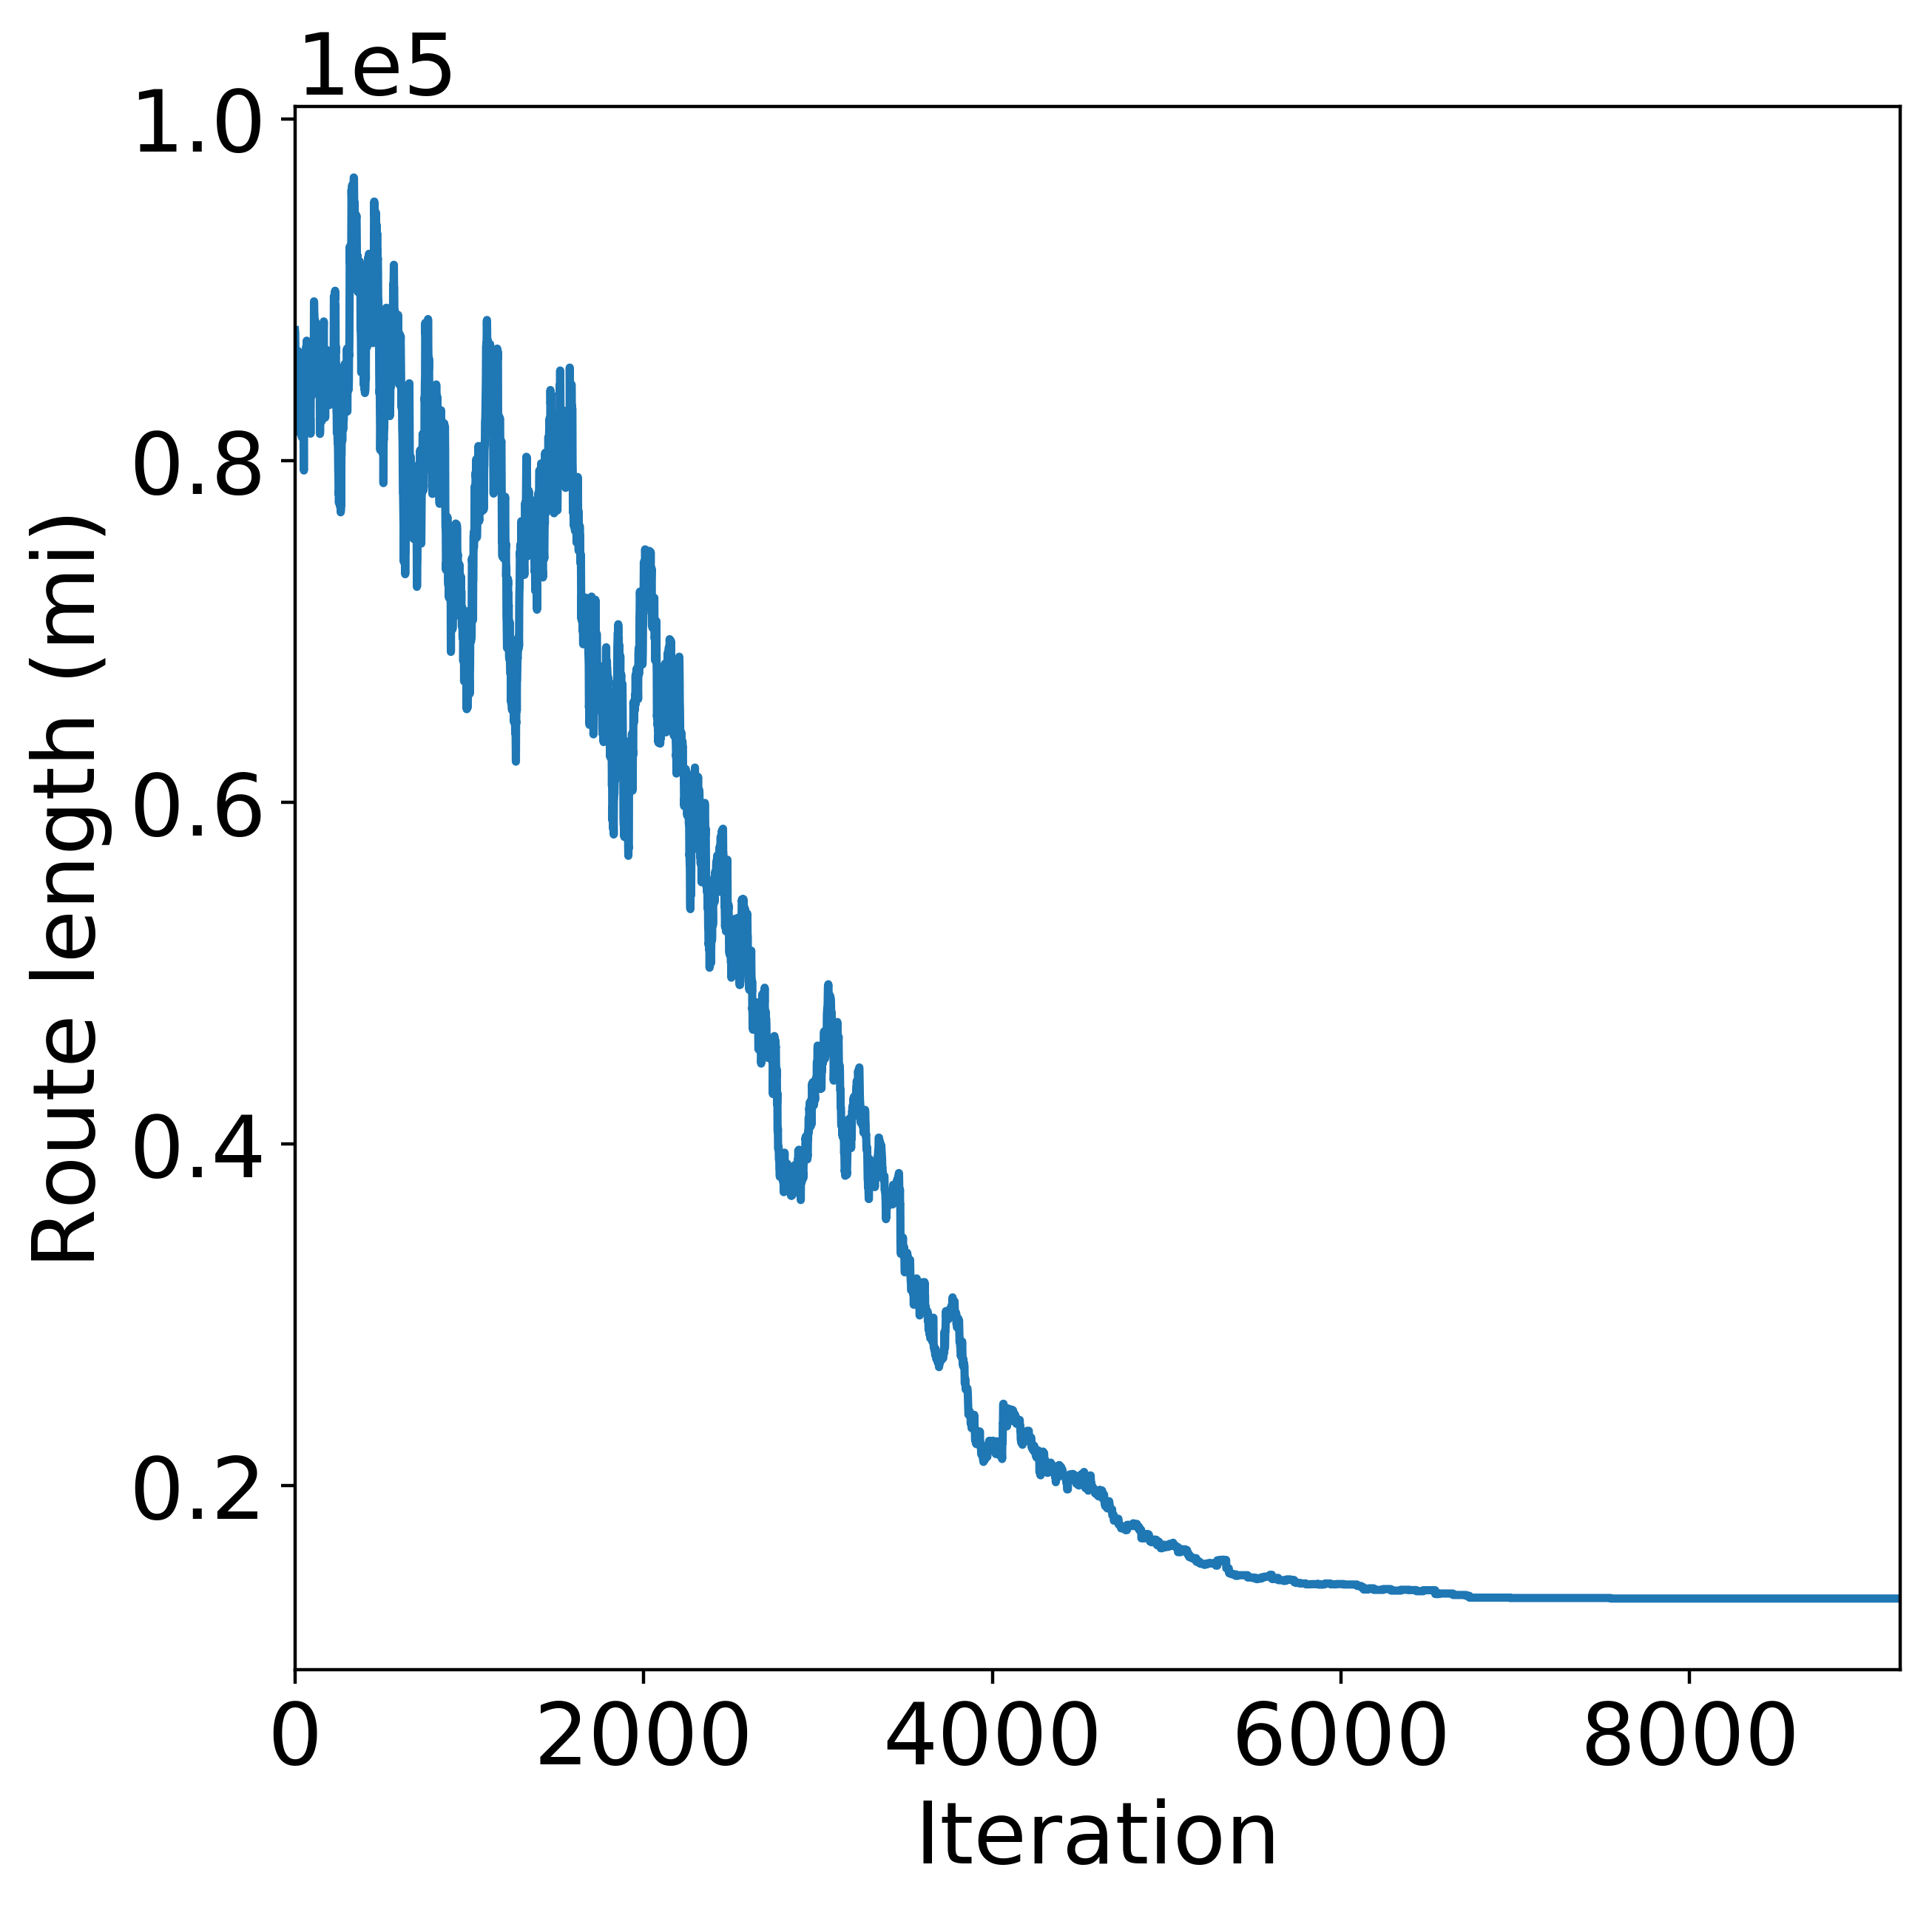
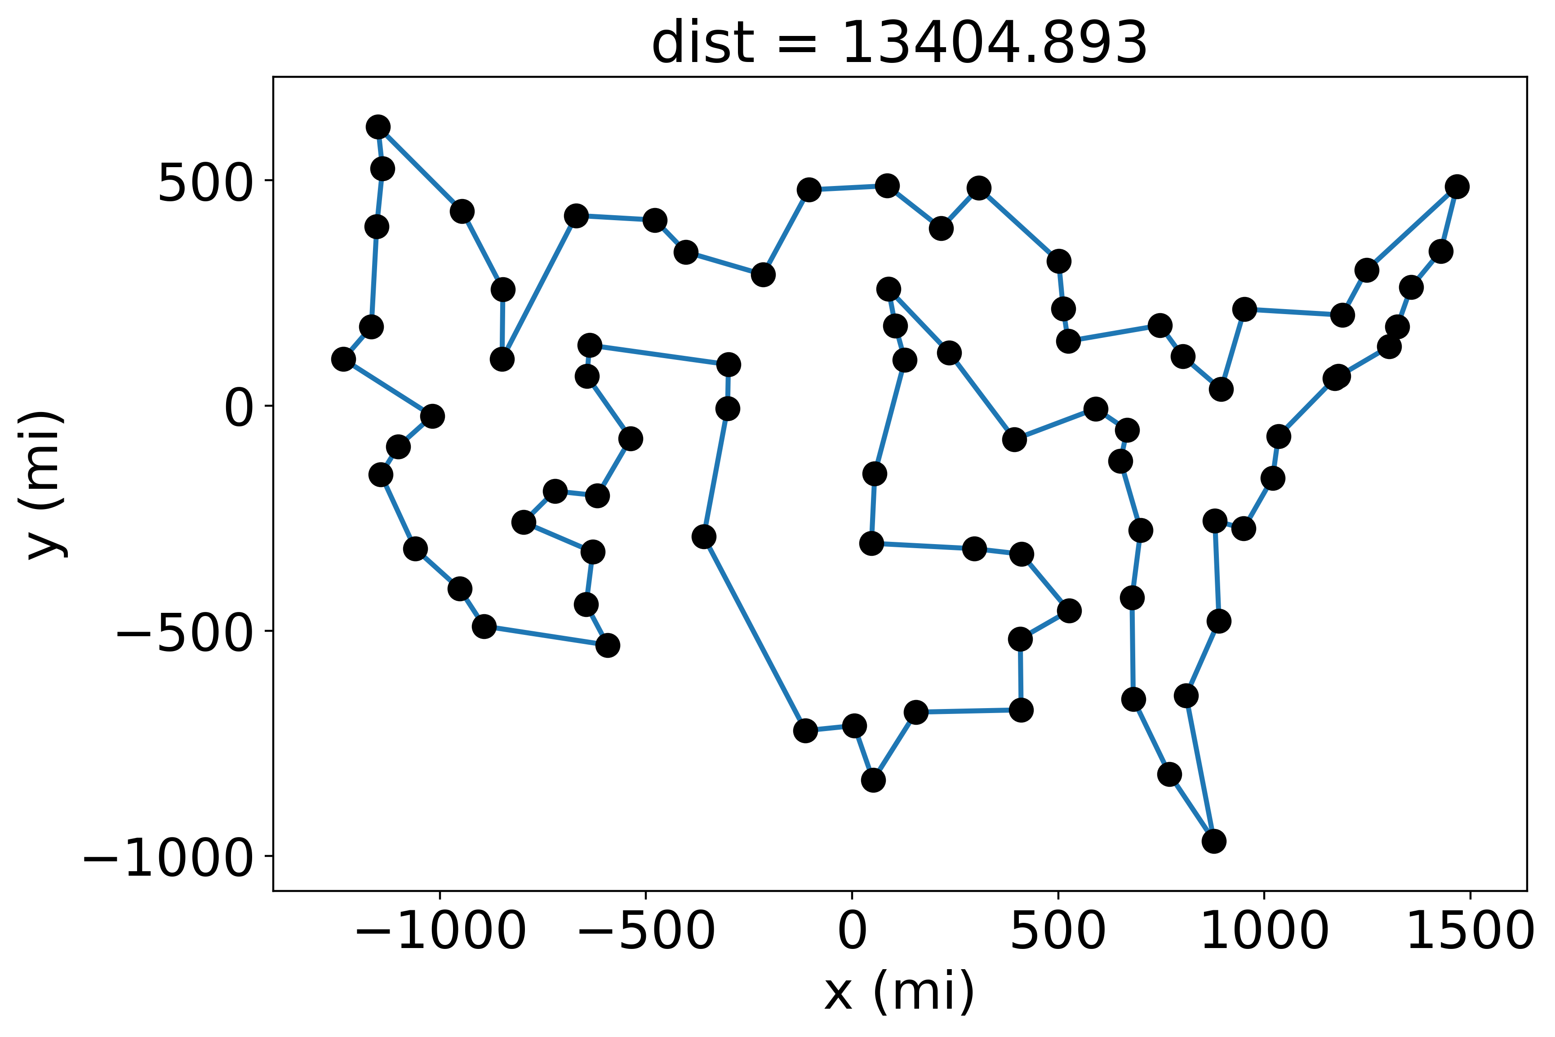
Simulated Annealing results

Slide 27
Genetic Algorithm
Inspired by Natural Selection
Uses mutation function from simulated annealing
Also has crossover (i.e. “breeding”) and selection
New Terminology
Population – a set of different routes for the same set of cities
Breeding – a process through which two routes create a new route that has similarities to each

Slide 28
The process
Create a population – take a set of cities, and make a bunch of different random routes through these cities
Select the mating pool – select the subset of the population that will be allowed to “breed” and make the next generation
Breeding – Take each pair of 2 routes, and make a new route that has similarities to each
Mutate – randomly alter some of the routes (using same method as mutation in simulated annealing)
Repeat for many generations

Slide 29
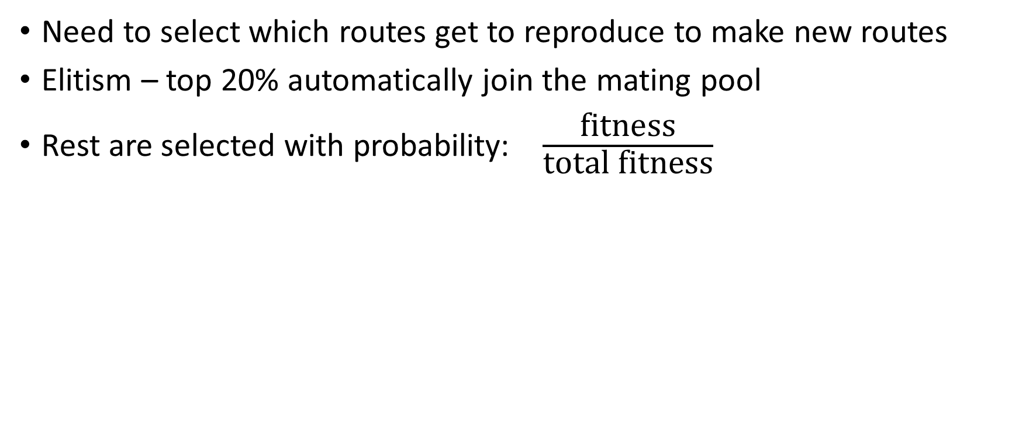
Select Mating Pool
Need to select which routes get to reproduce to make new routes
Elitism – top 20% automatically join the mating pool
Rest are selected with probability: $\frac{\text{fitness}}{\text{total} \text{fitness}}$

Slide 30
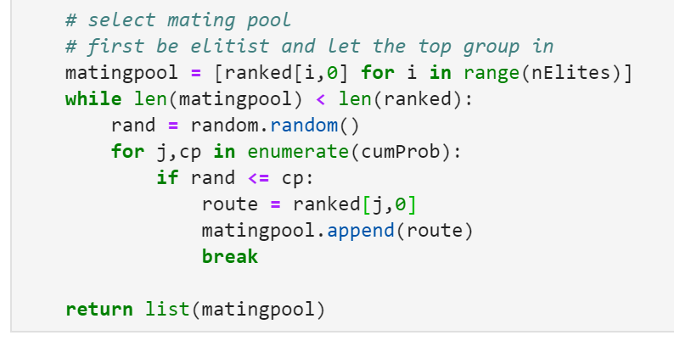

Slide 31
Breeding
Parent 1
Parent 2
1
3
2
5
4
5
3
1
2
4
5
3
2
1
4

Slide 32
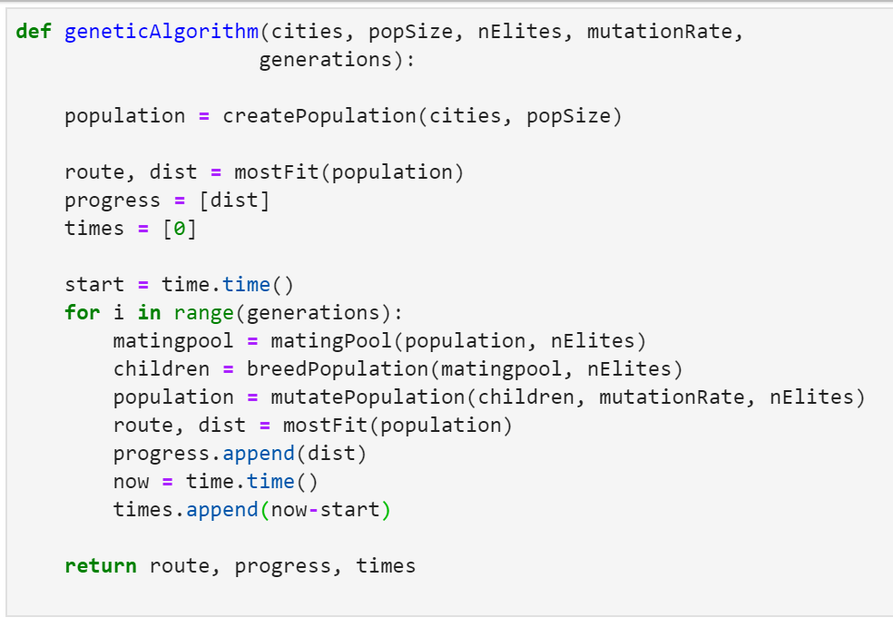

Slide 33
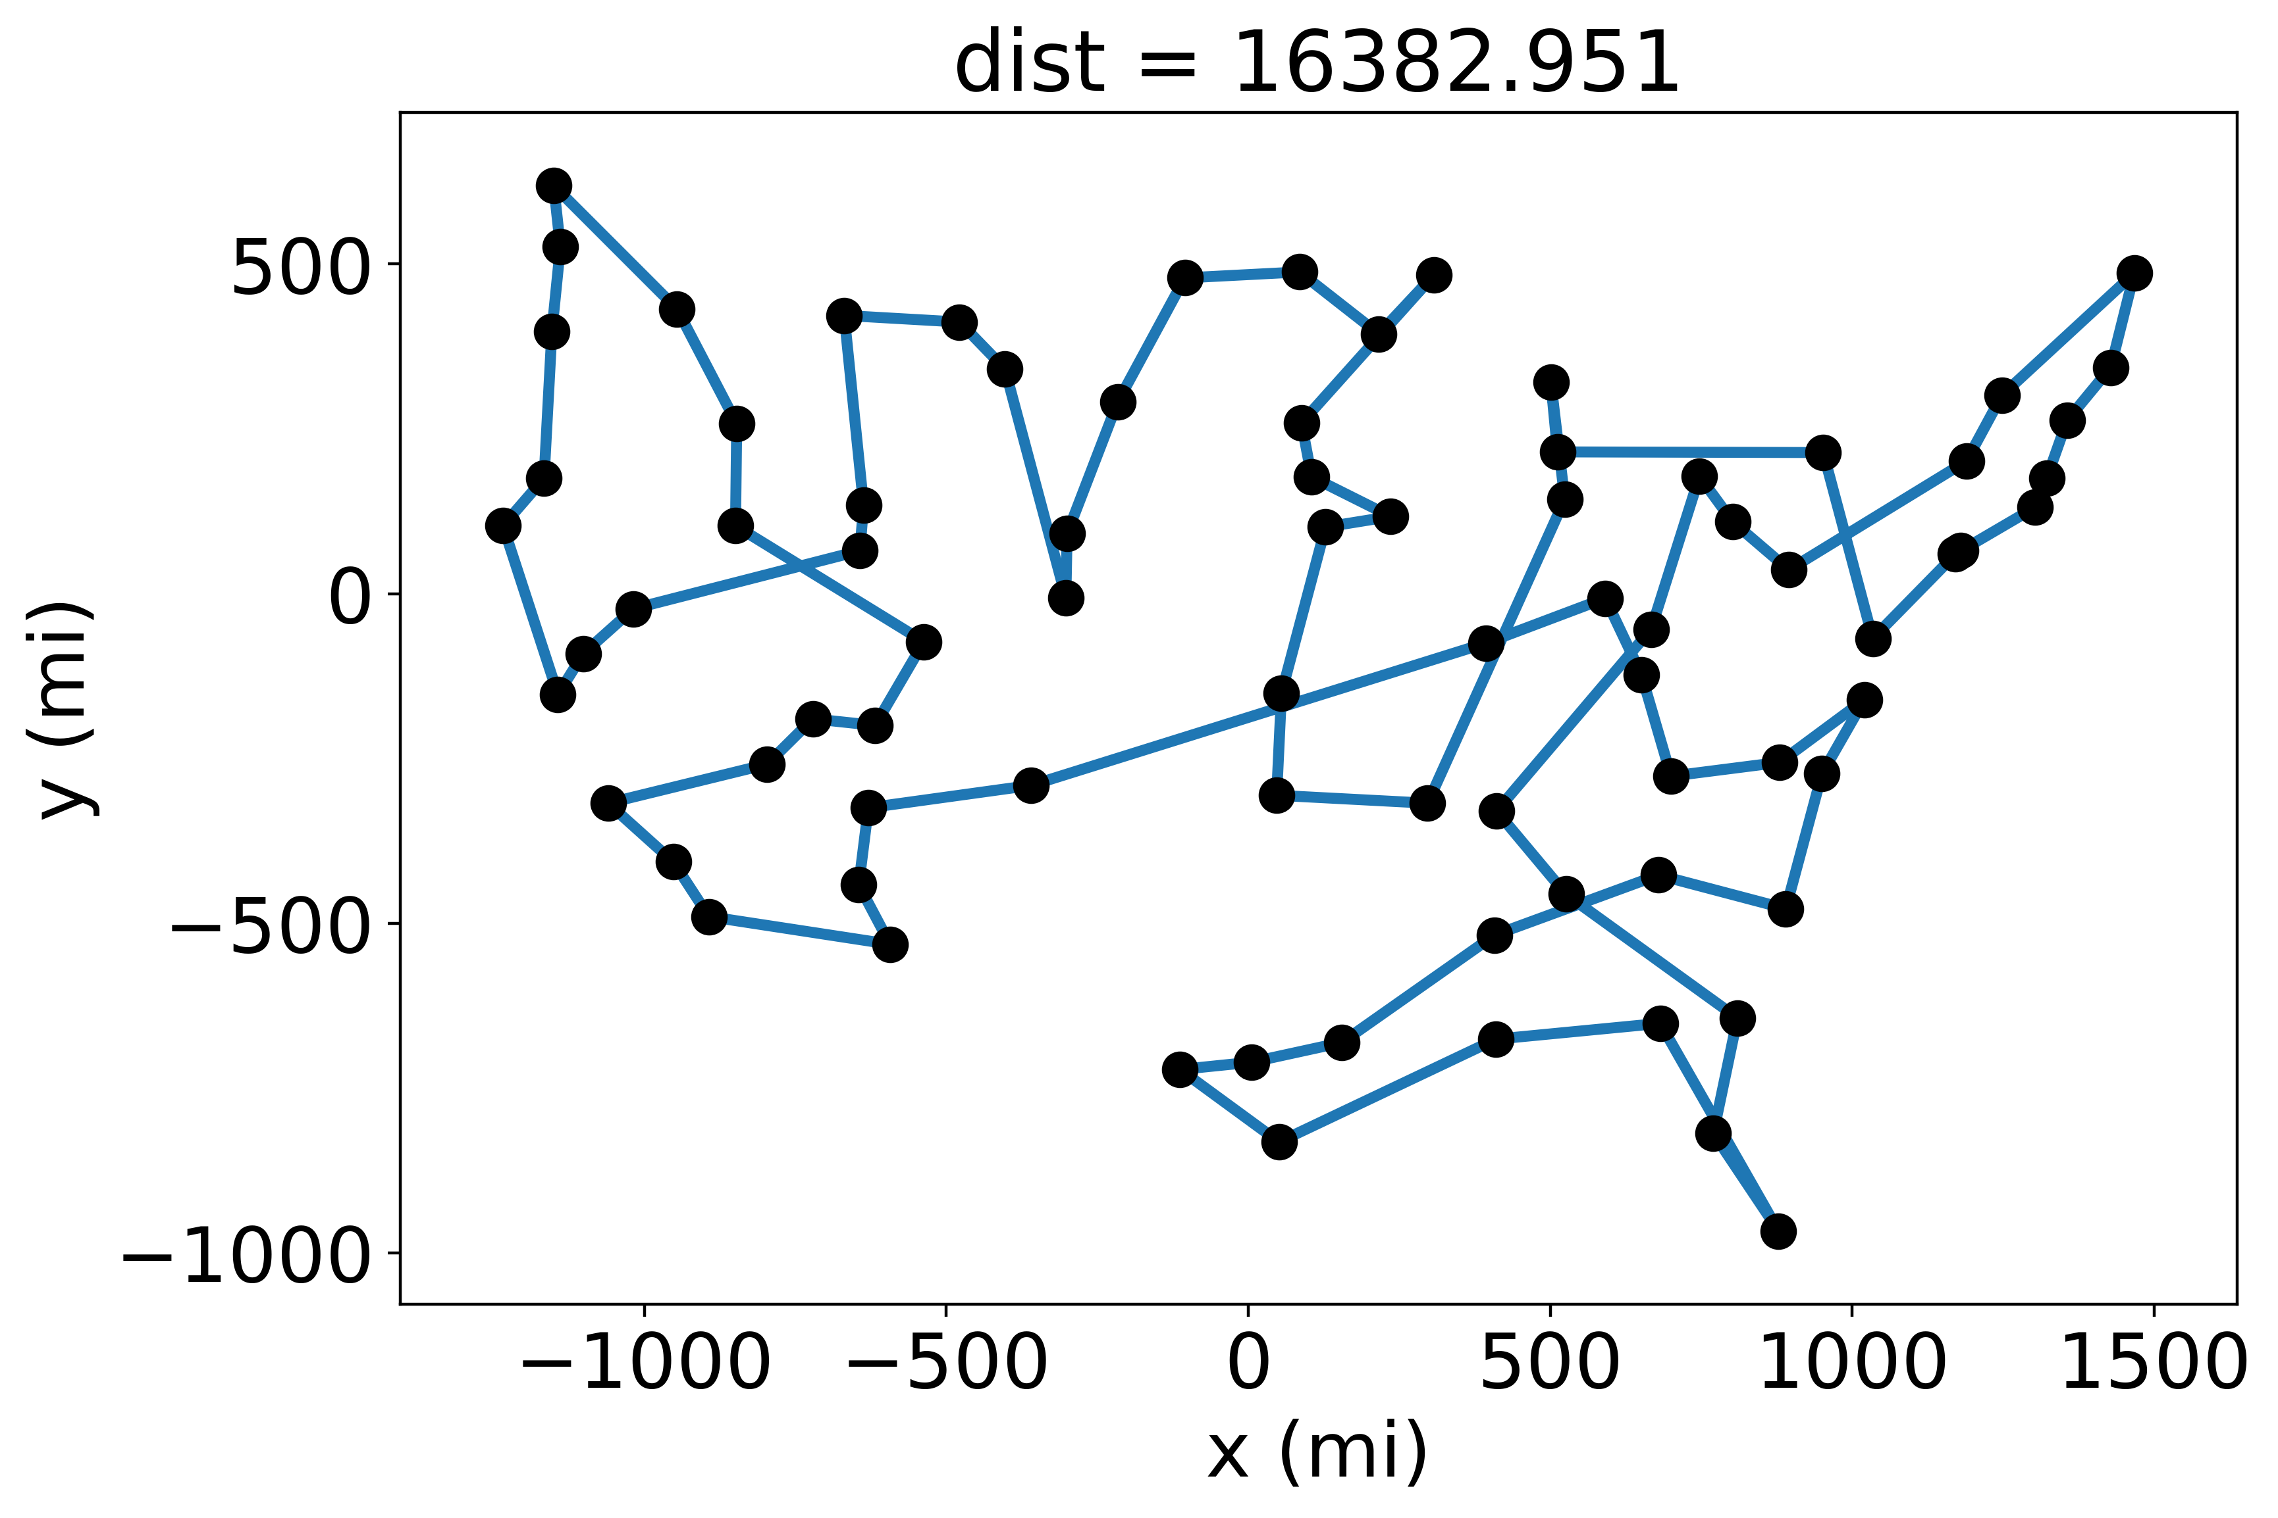
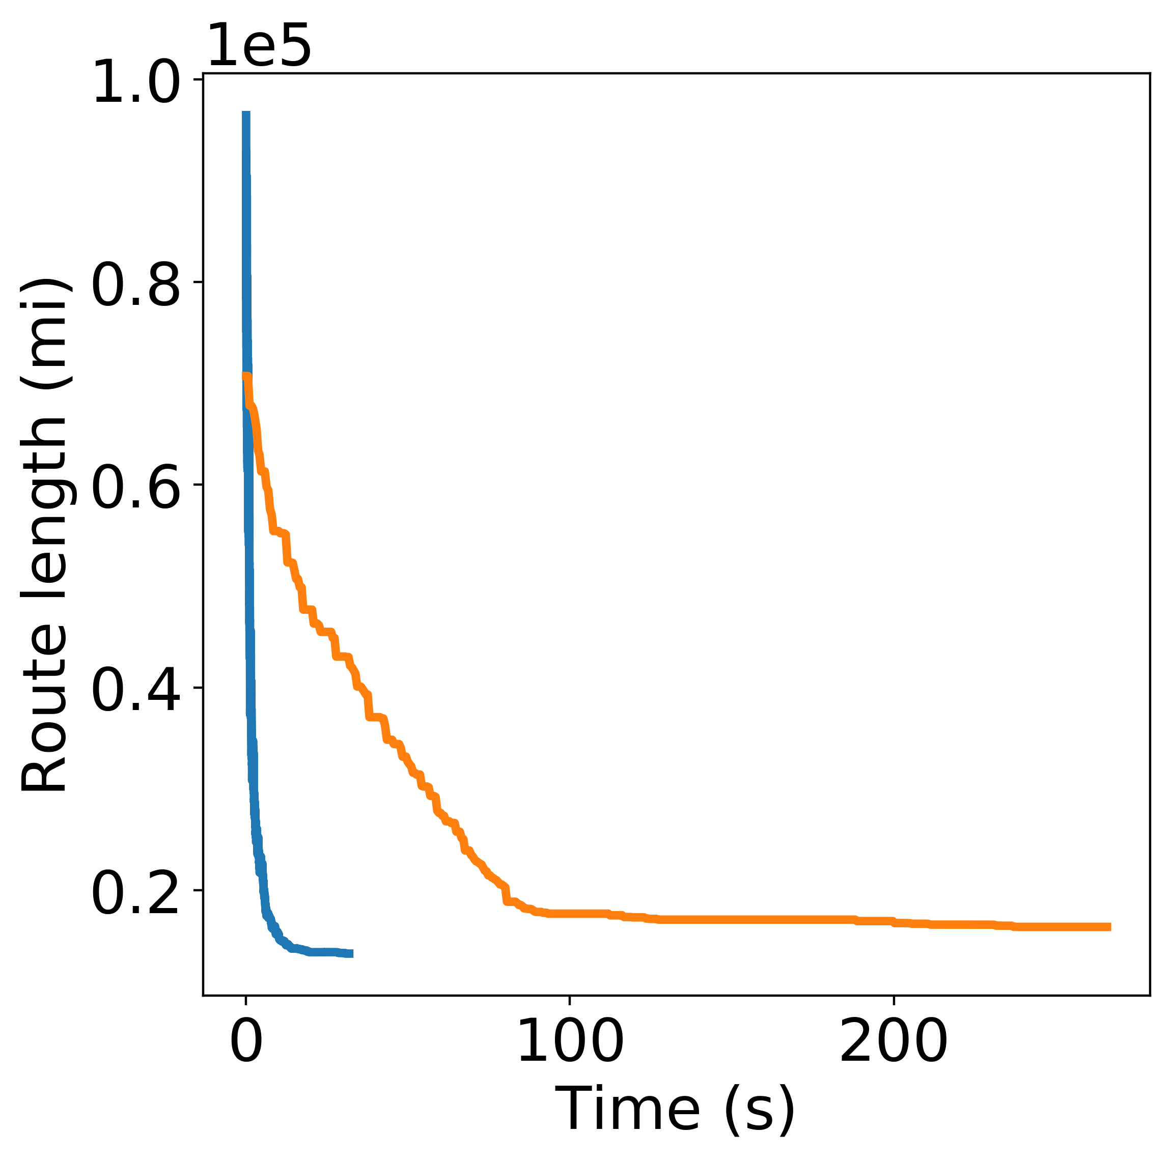
Genetic algorithm results

Slide 34
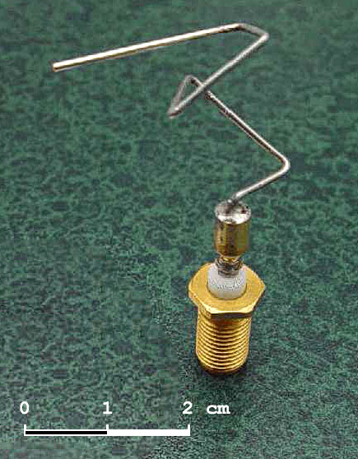
Other possible methods
Nearest neighbor, greedy algorithms, etc
Ant colony optimization
Applications
TSP – scheduling telescope observations, cabling, genetic engineering, etc
Discreet optimization – scheduling jobs on a computer, evolved antennae

Slide 35
Conclusions
The traveling salesman problem (and other problems in discrete optimization) is too computationally expensive to solve exactly
There are often clever heuristics you can use to improve performance if you really understand the problem
There are also probabilistic methods that aim to quickly approximate the optimal solution
These are typically good at avoiding local minima
These methods have many applications in discrete optimization

Slide 36
Included in files
TSPpres.pdf – this presentation in pdf format
traveling_salesman.ipynb – python notebook with all of the code
US_cities.txt – coordinates of 80 US cities used in tests

Slide 37
Sources
https://en.wikipedia.org/wiki/Travelling_salesman_problem
https://nbviewer.jupyter.org/url/norvig.com/ipython/TSP.ipynb
https://en.wikipedia.org/wiki/Simulated_annealing
https://www.fourmilab.ch/documents/travelling/anneal/
http://www.theprojectspot.com/tutorial-post/simulated-annealing-algorithm-for-beginners/6
https://towardsdatascience.com/evolution-of-a-salesman-a-complete-genetic-algorithm-tutorial-for-python-6fe5d2b3ca35

Slide 38
Images
https://xkcd.com/399/
http://www.math.uwaterloo.ca/tsp/usa50/index.html
https://www.machinemfg.com/annealing/
https://esa.github.io/pagmo2/docs/cpp/algorithms/sga.html
https://www.researchgate.net/figure/Simulated-Annealing-optimization-of-a-one-dimensional-objective-function_fig1_308786233
https://commons.wikimedia.org/wiki/File:St_5-xband-antenna.jpg

